Slide 1
Speed of biological computers
Dominique Chu
University of Kent
Canterbury, UK

Slide 2
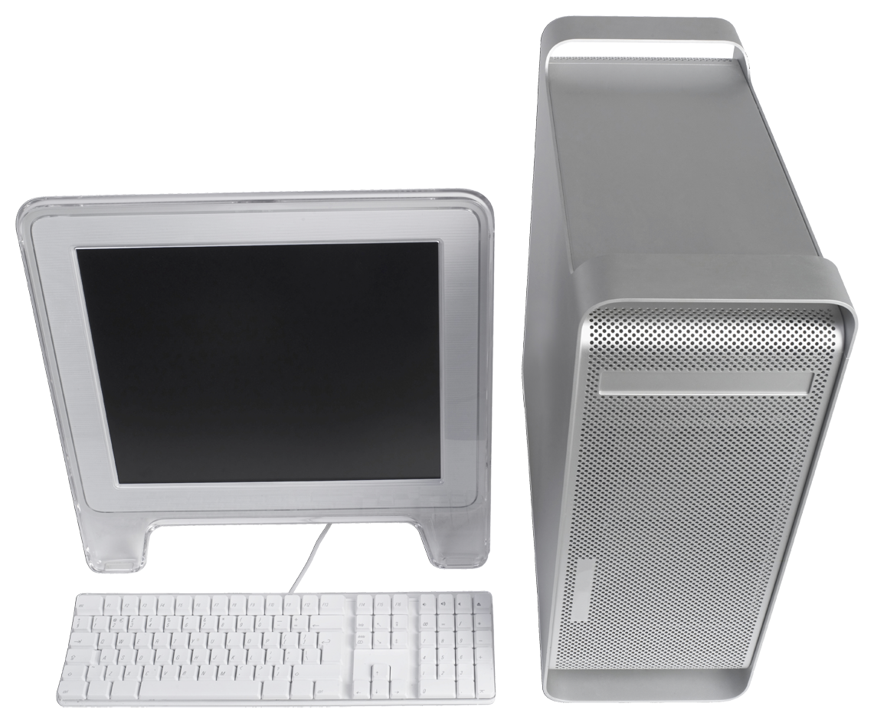
One computer

Slide 3
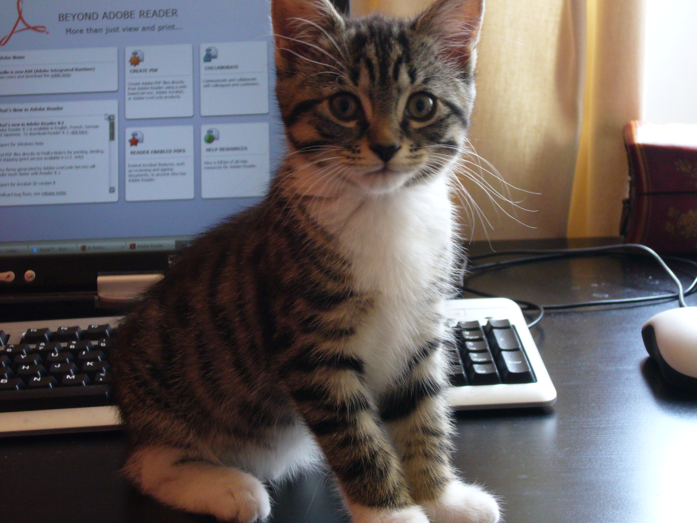
2 Computers

Slide 4
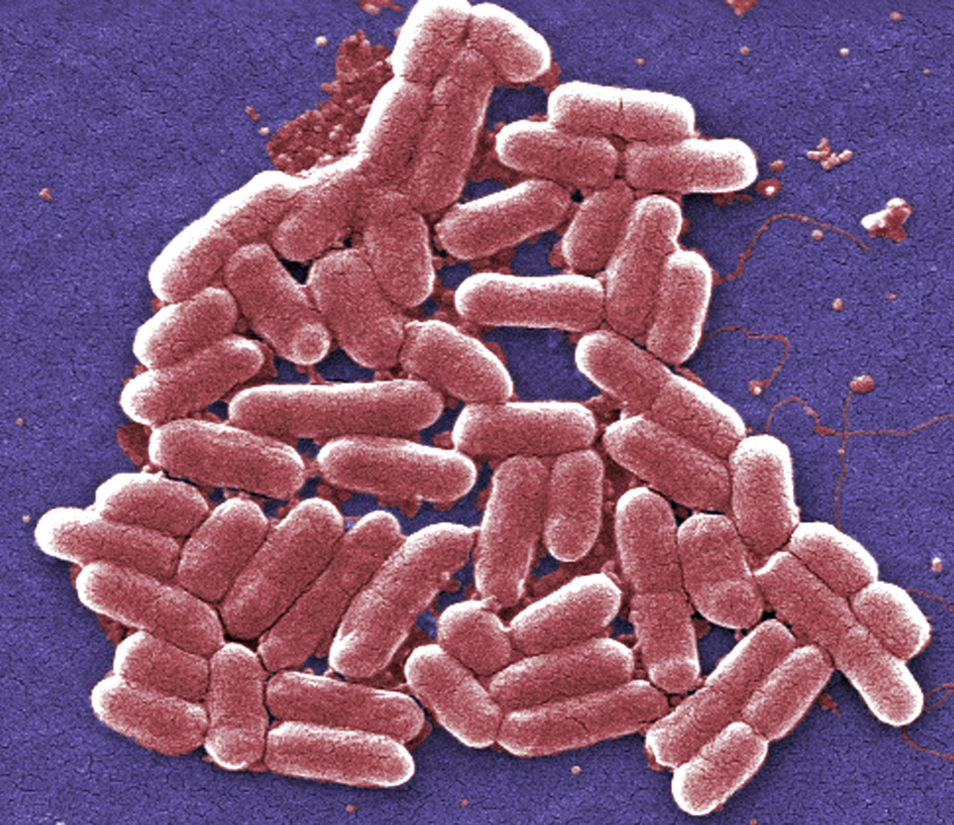
Many computers

Slide 5
QUESTION
If we consider biological systems as computational systems, what are their computational properties?
What limits them?
How do we measure their computational power?

Slide 6
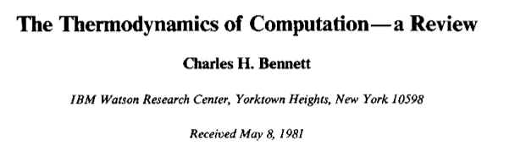
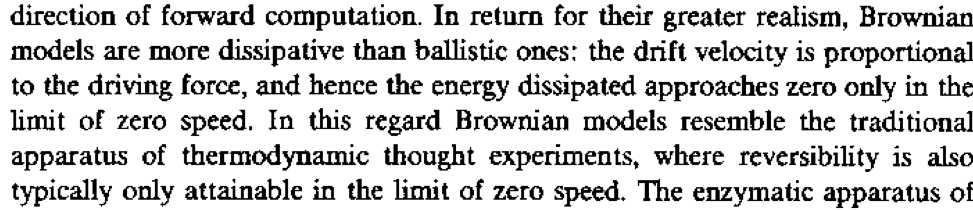

Slide 7
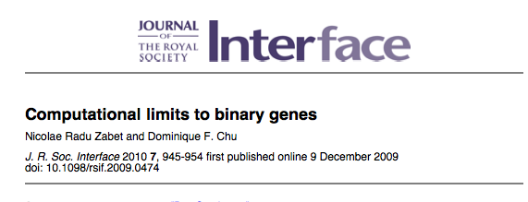
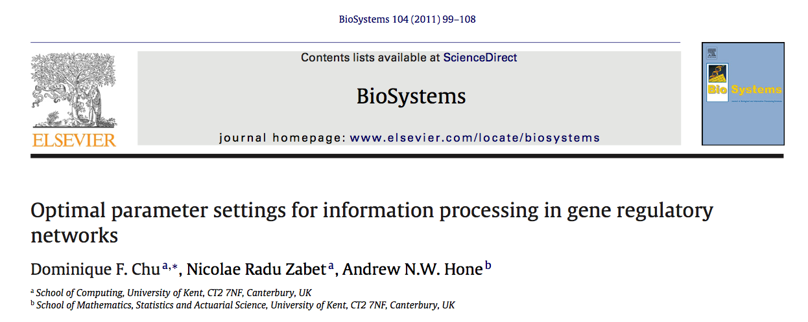

Slide 8
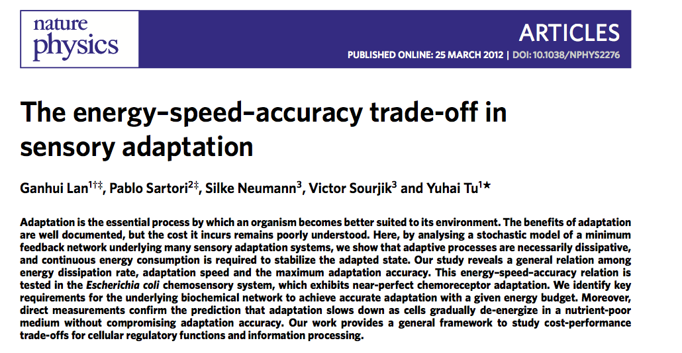

Slide 9
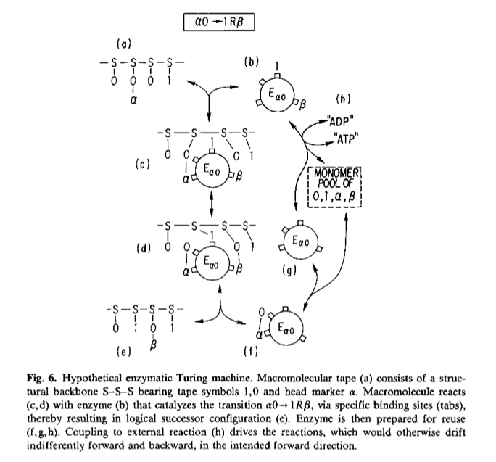

Slide 10
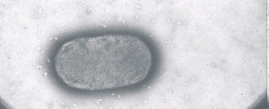
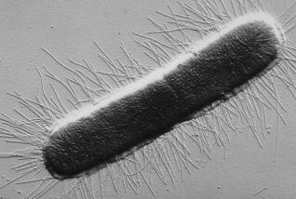
Example
Random bit generator

Slide 11
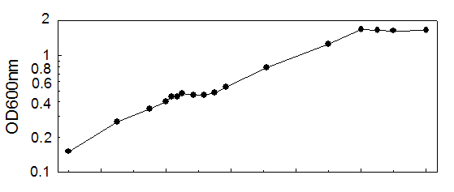
Example
Diauxic growth
Time
http://www.ou.edu/microarray/oumcf/diauxicgrowth.gif

Slide 13

Simple if-then

Slide 14
>

Slide 15
if (glucose) then
switchOnMetabolism(glucose)
fi;
else
if (lactose) then
switchOnMetabolism(lactose);
fi;

Slide 16
Simplest possible model system: binary Gene
Z

Slide 17
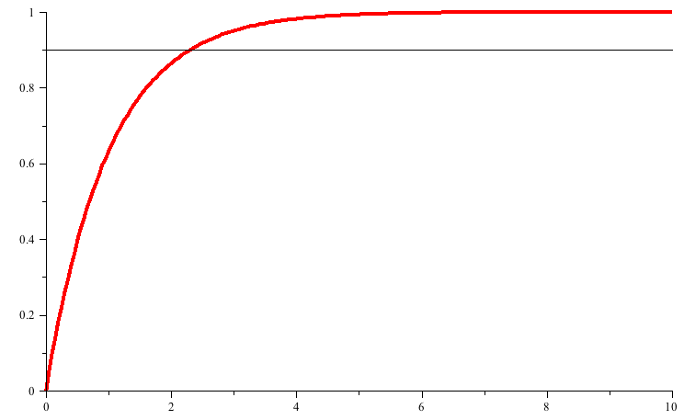
Deterministic model: output signal
Concentration of output particles
Time to switch on

Slide 18
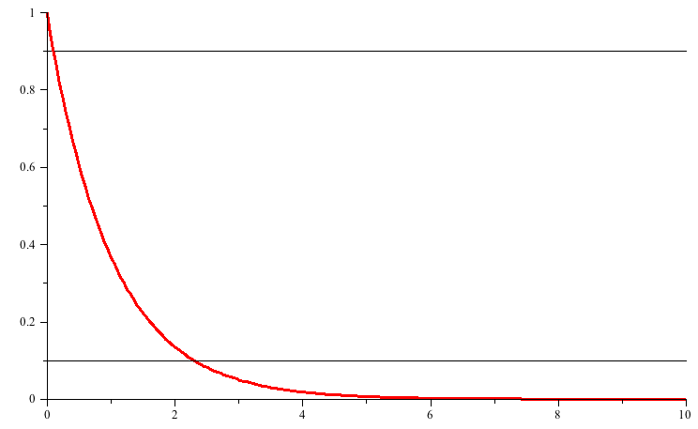
Deterministic model: output signal
Concentration of output particles
Time to switch off

Slide 19
Deterministic model: output signal
Concentration of output particles
Time to switch off

Slide 20
Noise/stochastic fluctuations
Noise calculated at steady state.
Normalised by the mean value.

Slide 21
Steady state

Slide 22
Steady state

Slide 23
Noise/stochastic fluctuations
Signal strength

Slide 24
Noise
Notes:
http://basil2.math.uwaterloo.ca/~bingalls/Pubs/ScottFOSBE.pdf

Slide 25
Noise-time trade-off
1 gene case:
We have ignored cost so far.
Define as the number of molecules produced per time unit (at maximum).

Slide 26
Noise-time-cost trade-off

Slide 27
3 genes
xH
Y
xL
Z

Slide 28
Noise-time trade-off
A)
As in the 1 gene case:
B)
There is an optimal for time and noise respectively

Slide 29
Summary
Speed of bio-computers is a valid question with tangible biological consequences.
Speed depends on a number of aspects, but also on the parameter values.
Biological computers cannot be understood without also understanding accuracy and the metabolic costs.
A thorough analysis of real systems is very complicated. However, I conjecture that the speed-accuracy-cost trade-off generalises.

Slide 31
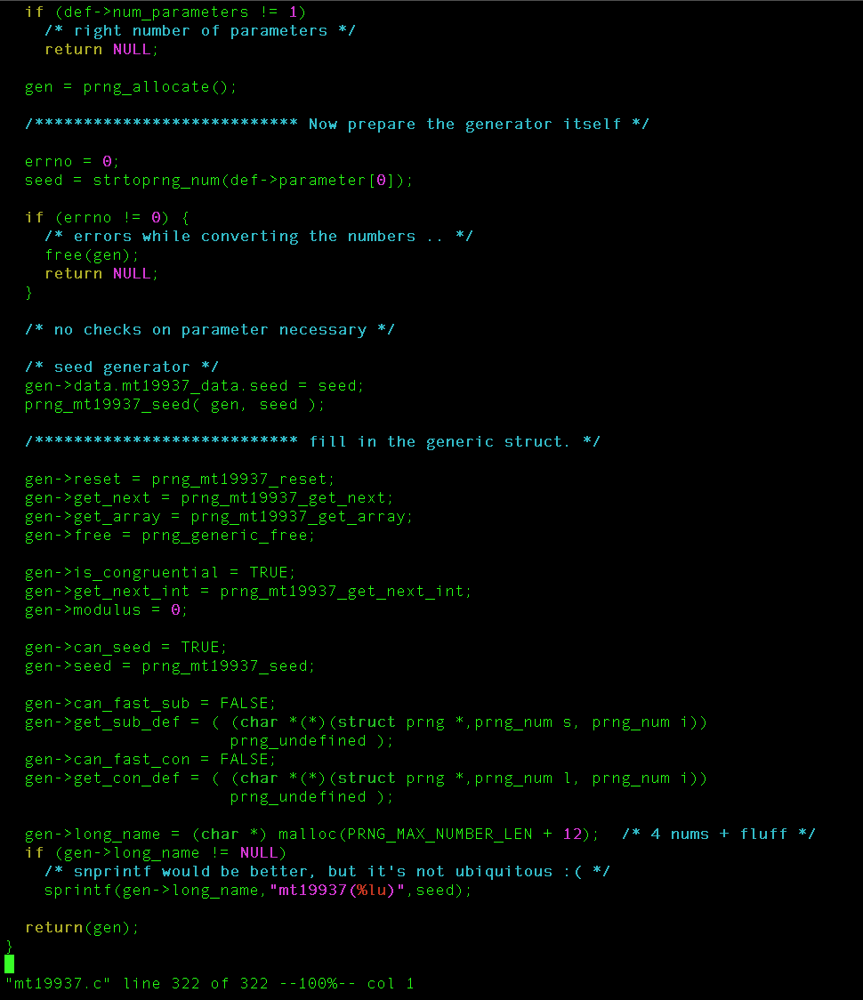
Otmar Lendl,
Mersenne Twister

Slide 32
Organisation of the fim/nan/nag operons
1.4kb
yjhS
yjhT
nanC
fimB
E
A
I
C
-- NagC ++
-- NanR ++
fimS
SlyA
IHF
Lrp
The system is integrating a number of environmental cues and adjusts the fimbriation probability accordingly.
Notes:
http://mic.sgmjournals.org/cgi/content/abstract/149/4/877
http://www.ploscompbiol.org/article/info%3Adoi%2F10.1371%2Fjournal.pcbi.1000723
http://jb.asm.org/cgi/reprint/190/10/3747
http://www.physics.mcgill.ca/~peter/253/computation.pdf

Slide 33
Speed
GHz, memory, HD/SSD type

Slide 34
Questions
How can we define the computational speed of biological computers?
What does it depend on?
Does this tell us anything about real biology?

Slide 35
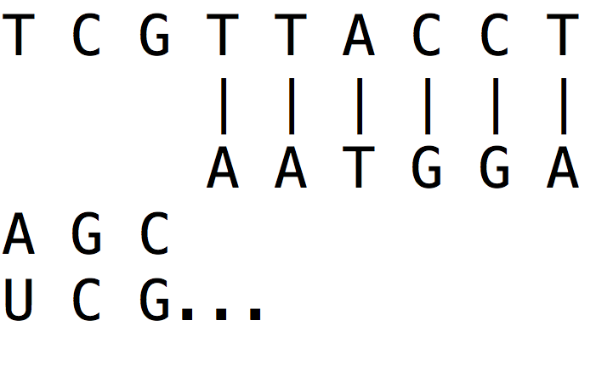
Speed
GHz, memory, HD/SSD type
energy dissipation per step

Slide 36
How about ?
In essence bio-chemical networks.
How about the speed of these systems?
Structure vs parameter

Slide 37
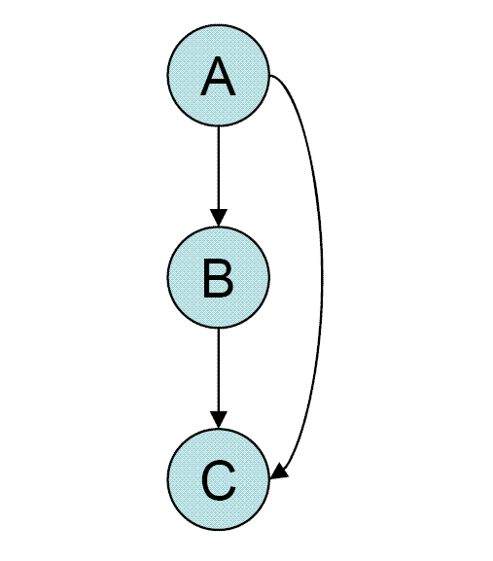
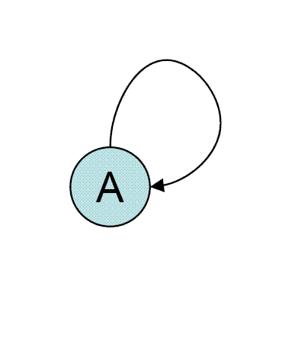
Structure

Slide 38
Parameters
They are difficult to measure.
Hence mostly ignored.
Big oversight!

Slide 39
Do I have a case?
Robustness of parameters is a common assumption.
Biosystems arguably depend on this.
Do parameters really matter?

Slide 40
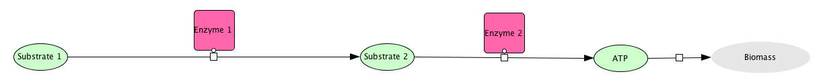
A very simple example system
(simplified representation)

Slide 41
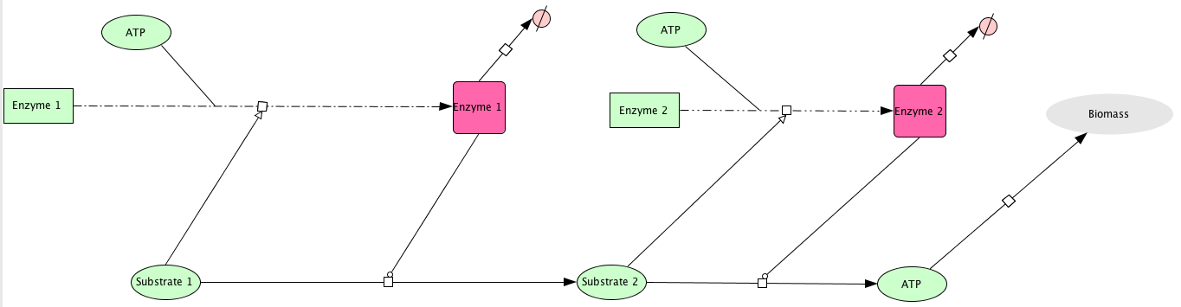
A very simple example system
(full representation)

Slide 42
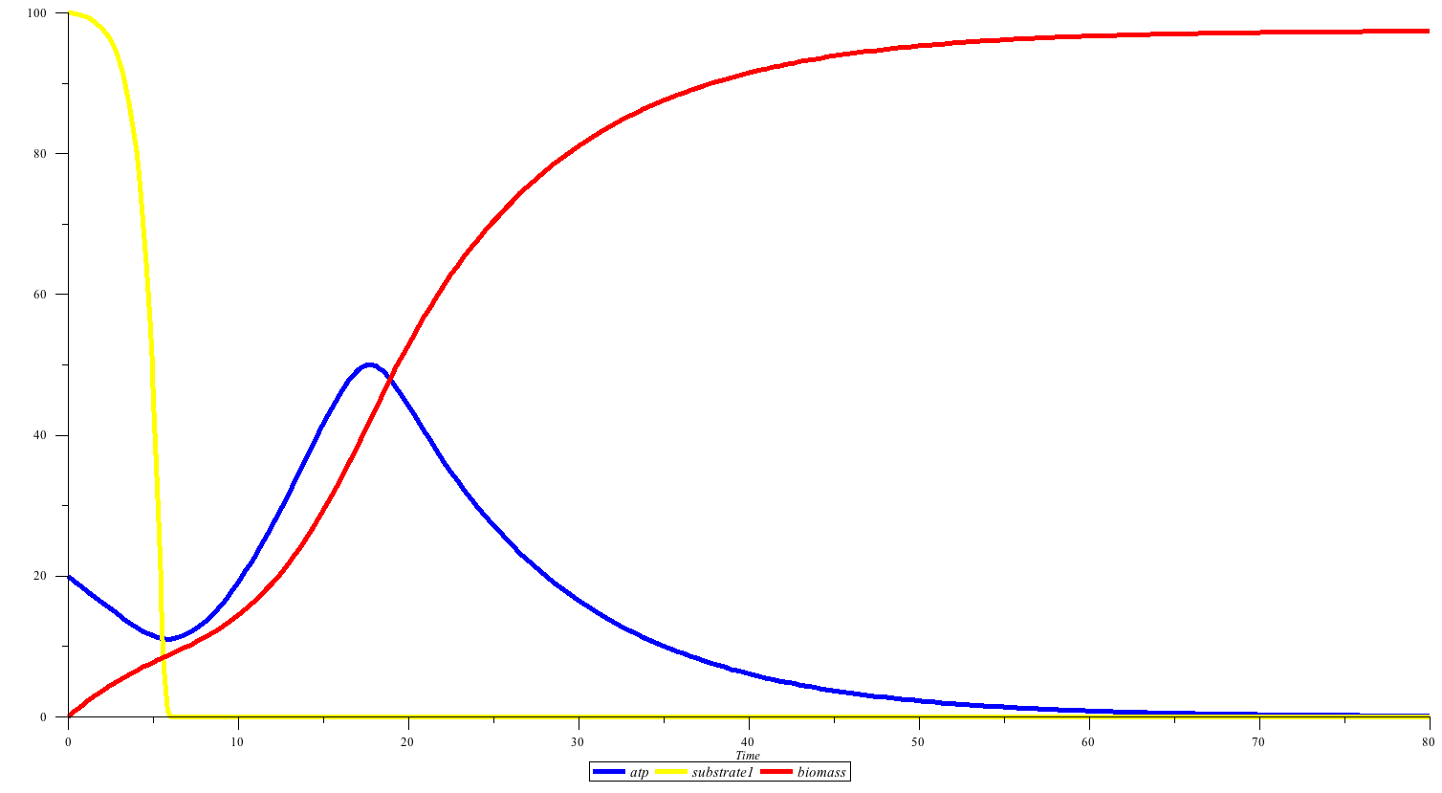
Concentration [arbitrary units]
Time [arbitrary units]

Slide 44
Using artificial evolution
I conclude: Parameters are indeed important

Slide 45
The system: a single gene
TF-binding sites
gene
TFs
DNA

Slide 46
The system

Slide 47
Deterministic model: output signal
Concentration of output particles
Time to switch on

Slide 48
Deterministic model: output signal
Concentration of output particles
Time to switch off

Slide 49
Deterministic model: output signal
Concentration of output particles
Time to switch off

Slide 50
Noise/stochastic fluctuations
Noise calculated at steady state.
Normalised by the mean value.

Slide 51
Steady state

Slide 52
Steady state

Slide 53
Noise/stochastic fluctuations
Signal strength

Slide 54
Noise
Notes:
http://basil2.math.uwaterloo.ca/~bingalls/Pubs/ScottFOSBE.pdf

Slide 55
Noise-time trade-off
1 gene case:
We have ignored cost so far.
Define as the number of molecules produced per time unit (at maximum).

Slide 56
Noise-time-cost trade-off

Slide 57
3 genes
xH
Y
xL
Z

Slide 58
Noise-time trade-off
A)
As in the 1 gene case:
B)
There is an optimal for time and noise respectively

Slide 59
Summary
Speed of bio-computers is a valid question with tangible biological consequences.
Speed depends on a number of aspects, but also on the parameter values.
Biological computers cannot be understood without also understanding accuracy and the metabolic costs.
A thorough analysis of real systems is very complicated. However, I conjecture that the speed-accuracy-cost trade-off generalises.

Slide 60
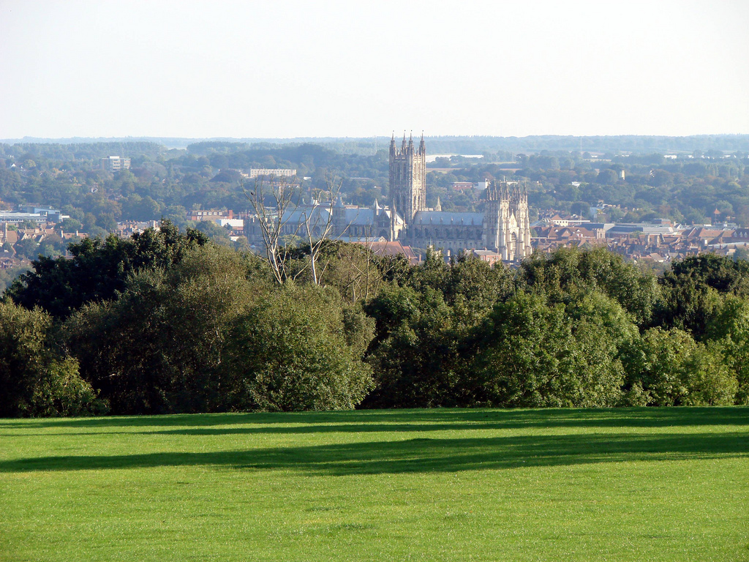
http://farm4.staticflickr.com/3377/3223087964_1ef16c42c5_b.jpg

