Slide 1

2012 British Mathematical Colloquium (BMC), University of Kent
Workshop on Turing’s Legacy in Mathematics & Computer Science
17th April 2012
Introduction: The Limits to Computation
Greg Michaelson
School of Mathematical & Computer Sciences
Heriot-Watt University

Slide 2
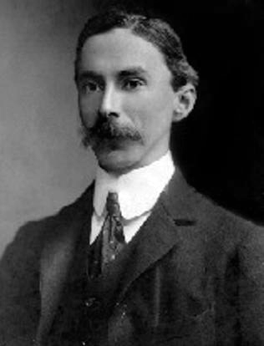
Russell’s Paradox
1901
Bertrand Russell
naive set theory is contradictory
self-reference
set of all sets which are not members of themselves

Slide 3

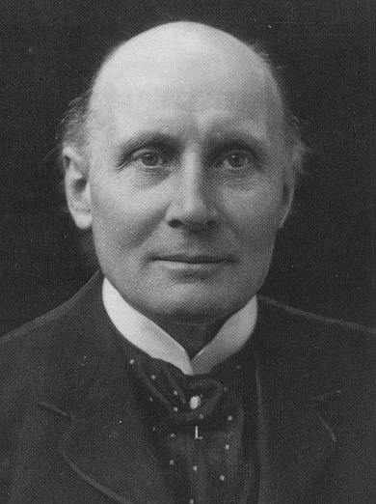
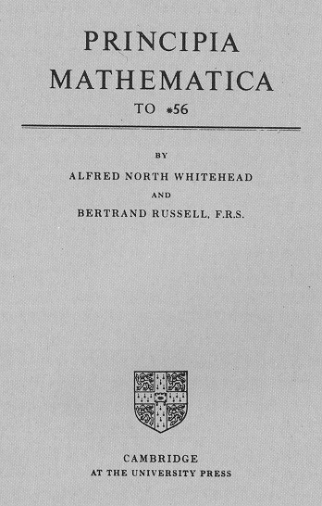
Principia Mathematica
1910-13
Alfred North Whitehead
Bertrand Russell
show that all mathematics can be derived from symbolic logic

Slide 4
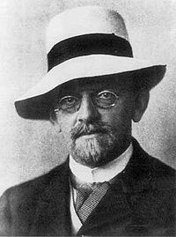
Hilbert’s Programme
1920
David Hilbert
show that Russell & Whitehead formalisation is:
  consistent: no contradictions
  complete: no unprovable theorems
  decidable: algorithm to determine if a mathematical assertion is a theorem
    entscheidungsproblem

Slide 5
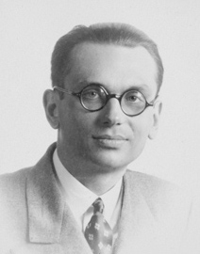
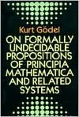
Gödel’s Incompleteness Theorems
1931
Kurt Gödel
Russell & Whitehead mathematics is incomplete
self-referential contradiction
this theorem is not a theorem

Slide 6
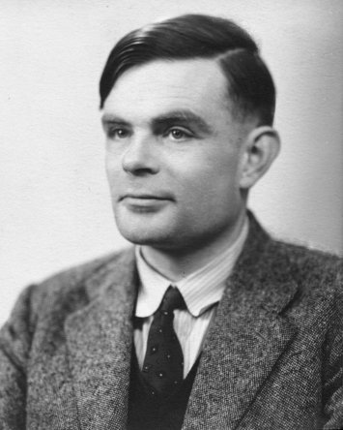
Turing Machines
1936
Alan Turing
model of computability
machine inspects tape of cells with symbols
tape can move left or right
machine controlled by state to state transitions
old state * old symbol -> new state * new symbol * direction

Slide 7
Turing Machines
TM machine embodies a specific computation
Universal Turing Machine
interpreter for any TM + tape description

Slide 8
Turing Machines
entscheidungsproblem ➔
  does arbitrary TM halt over arbitrary tape?
undecidable
diagonalisation + self-referential contradiction
this TM only halts if it doesn’t halt

Slide 9
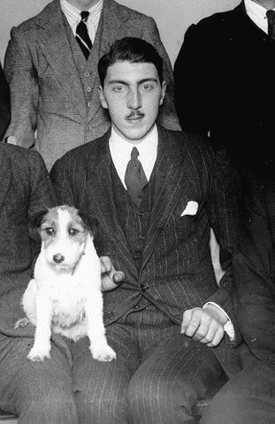
λ-Calculus
1936
Alonzo Church
model of effective calculability
λ expression:
  λ id.exp function
  (exp exp) application
  id identifier
β reduction
(λ id.exp₁ exp₂) ==> exp₁[id/exp₂]

Slide 10
λ-Calculus
λ expression is in normal form if no more β reductions apply
entscheidungsproblem ➔
  does arbitrary λ expression have a normal form?
undecidable
diagonalisation + contradiction

Slide 11
Church-Turing Thesis
Turing(1936):
  In a recent paper Alonzo Church has introduced an idea of "effective calculability", which is equivalent to my "computability", but is very differently defined. Church also reaches similar conclusions about the Entscheidungsproblem. The proof of equivalence between "computability“ and "effective calculability" is outlined in an appendix to the present paper.

Slide 12
Church-Turing Thesis
  To show that every λ-definable sequence γ is computable, we have to show how to construct a machine to compute γ....
  To prove that every computable sequence γ is λ-definable, we must show how to find a formula M_{γ} such that, for all integers n,
      {M_{γ}} (N_{n}) conv N_{1+φγ(n)}...
    i.e. M_{γ} is a λ expression that behaves like machine γ on input N_{n}

Slide 13
Church-Turing Thesis
all models of computability are equivalent:
  can translate any instance of one model into an instance of any other model
  can construct an interpreter for any model in any other model
formal results for any model have equivalences in any other model
applies to idealised:
  von Neumann machines
  programming languages

Slide 14
Logical Challenges
there are formal models of computability in which undecidable properties of TMs are decidable
Wegner (1997)
  TM tape can’t change under external influence during computation
  interaction machines
Wegner & Eberbach (2004)
  π calculus
  $ calculus = π calculus + von Neumann/Morgernstern utility functions

Slide 15
Physical Challenges
there are physical systems for which undecidable properties of TMs are decidable
  accelerating TMs - Copeland (2001)
  Malament-Hogarth space-time computation(1992) - Etesi & Nemeti (2002)
  analogue/real number computing
    Analog X machines – Stannett (1990)
    da Costa & Doria (2009)

Slide 16
The Challengers Challenged
lots of people, including Cockshott, Mackenzie & Michaelson (2012)
what are the concrete:
  TM undecidable problems which are now semi-decidable?
  TM semi-decidable problems which are now decidable?
  TM undecidable problems which are now decidable?
  canonical/defining instances of the above?
can it actually be built?

Slide 17
References
A. D. Irvine, "Russell's Paradox", The Stanford Encyclopedia of Philosophy (Summer 2009 Edition), Edward N. Zalta (ed.), URL = <http://plato.stanford.edu/archives/sum2009/entries/russell-paradox/>.
A. N. Whitehead and B. Russell. Principia Mathematica, 3 vols, Cambridge University Press, 1910, 1912, and 1913. Second edition, 1925 (Vol. 1), 1927 (Vols 2, 3).
R. Zach, "Hilbert's Program", The Stanford Encyclopedia of Philosophy (Spring 2009 Edition), Edward N. Zalta (ed.), URL = <http://plato.stanford.edu/archives/spr2009/entries/hilbert-program/>.
K. Godel, 1992. On Formally Undecidable Propositions Of Principia Mathematica And Related Systems, tr. B. Meltzer, with a comprehensive introduction by Richard Braithwaite. Dover reprint of the 1962 Basic Books edition.
A. M. Turing, "On computable numbers, with an application to the Entscheidungsproblem", Proceedings of the London Mathematical Society, Series 2, 42 (1937), pp 230–265.
A. Church, "An unsolvable problem of elementary number theory", American Journal of Mathematics, 58 (1936), pp 345–363
P. Wegner, “Why interaction is more powerful than algorithms”, Communications of the ACM, Vol. 40, Issue 5, pp80-91, May 1997
P. Wegner and E. Eberbach, “New Models of Computation”, Computer Journal, vol.47, no.1, 2004, 4-9.

Slide 18
References
P. B. J. Copeland, ”Accelerating Turing Machines”Minds and Machines 12: 281–301, 2002
M. Hogarth, 1992, “Does General Relativity Allow an Observer to View an Eternity in a Finite Time?”, Foundations of Physics Letters, 5, 173–181
G. Etesi, and I. Nemeti, 2002 “Non-Turing computations via Malament-Hogarth space-times”, Int.J.Theor.Phys. 41 (2002) 341–370
M. Stannett (1990) 'X-machines and the Halting Problem: Building a super-Turing machine'. Formal Aspects of Computing 2, pp. 331-41.
N.C.A. da Costa and F.A. Doria, “How to build a hypercomputer,” Applied Mathematics and Computation, Volume 215, Issue 4, 15 October 2009, Pages 1361-1367
P. Cockshott, L. M. Mackenzie and G. Michaelson, Computation and its Limits, OUP, 2012

Slide 19
Visions of Johanna
Inside the museum, Infinity goes up on trial.
Voices echo this is what salvation must look like after a while...
Bob Dylan(1966)

