Slide 1
Options for Stage 2
21st March 2011

Slide 2
Overview
At least 5 compulsory modules
  Up to 3 options this year
Options not taken in stage 2 usually available in stage 3
  Cannot do too many level I modules
Handbooks already available
Online module registration on SDS
  Closes 1st April
  Options can be changed later
  Must register even if you have 8 compulsory modules

Slide 3
Compulsory non-CO modules
CS(AI)
  PL609
WCo
  EL531
  EL631 (30 credits)
CSMS
  CB302
  CB667
  CB669*
CS(Bus)
  CB514
  CB676
  CB681
  CB677 / CB683
CoBA
  CB683
  CB676
  CB677
  CB681

Slide 4
Autumn term
CO522 Algorithms, Data Structures & Complexity
CO526 Distributed Systems & Networks
CO529 Human-Computer Interaction
CO531 Software Engineering Practice
CO534 IT Consultancy Methods
CO538 Concurrency Design & Practice
CO636 Cognitive Neural Networks

Slide 5
Spring term
CO525 Dynamic Web
CO527 Operating Systems & Architecture
CO528 Introduction to Intelligent Systems
CO532 Database Systems
CO535 IT Consultancy Practice 1
CO536 Advanced Programming Techniques
CO537 Functional Programming

Slide 6
Which modules do I take?
☑ compulsory ◻ optional ☒ not available
◻ CS
◻ CS(AI)
CS(Con)
CS(Net)
◻ CS(Bus)
CSMS
CoBA
WCo
If you want to change degree programme for next year do so before completing online module registration

Slide 7
CS(Consultancy)
Entry to Stage 2 of the CS(Consultancy) programme is subject to interview and may also be subject to quota.
Students completing Stage 1 but unable to enter Stage 2 of CS(Consultancy) will transfer to an alternative CS programme.

Slide 8
KITC
The Kent IT Clinic

Slide 9
Background to the KITC
The Kent IT Clinic is a business run by the School of Computing and the University.
Clients are small to medium sized enterprises located within Kent.
Clients pay the KITC for the services it provides them with.
The KITC has its own offices and infrastructure, separate from the School.

Slide 10
Who does what
The KITC is run and managed by a Co-ordinator, not by academics. It has an Advisory Board.
The Co-ordinator and Consultants do the work, meet the clients, etc.
Academic supervisors do not meet clients nor do they undertake any KITC work. They are not responsible in any way for the outcome of any KITC endeavour, but they can advise.

Slide 11
Consultants
Consultants (students) work for the KITC.
They are rewarded with credits towards an academic module (CO645, CO650, CO535 and CO843)
Or they can be paid.
They get one or the other for each piece of work they do, not both!
Typically they earn credits during term time and money during vacations (if any work is on offer).

Slide 12
The work KITC Consultants do
Work under contracts with external clients.
Contribute to KITC infrastructure.
Develop platforms or services to be offered to future clients.
Formulate proposals for the future development of the KITC

Slide 13
CO534 IT Consultancy Methods
◻ CS
☒ CS(AI)
CS(Con)
◻ CS(Net)
◻ CS(Bus)
CSMS
CoBA
☒ WCo
Autumn
CO535 IT Consultancy Practice 1
◻ CS
☒ CS(AI)
CS(Con)
CS(Net)
◻ CS(Bus)
CSMS
CoBA
☒ WCo
Spring

Slide 14
CO534 and the KITC Practical Modules
CO534 is a taught module intended to support the modules based on practical consultancy work for the Kent IT Clinic (i.e. CO535, CO645, CO650 and CO843), and is a prerequisite for them (i.e. if you take any of the practical modules, you have to take CO534 in an earlier term).
However, you can take CO534 even if you have no intention of taking any of the practical modules.

Slide 15
Topics within CO534
Starting a project.
Quality management.
Planning and estimation.
Configuration and document control.
Managing a project.
Dealing with risk.
Robust and accessible website design.
Issue tracking.
Project closure.
There will inevitably be some overlap with other modules.

Slide 16
Coursework
Topics
CO534 is assessed by 50% coursework, 50% examination.
Among the coursework topics are:
  Analysing the role of consultancies;
  Training in safe handling of electrical equipment;
  Role-play exercises exploring client/consultancy relationships;
  A simulation of a day's consultancy business;

Slide 17
The KITC Practical Modules
CO535 IT Consultancy Practice 1: A 15-credit module normally taken in the Spring Term of Stage 2 (Canterbury only).
CO645 IT Consultancy Practice 2: A 15-credit Stage 3 module. At Medway it is taken in the Spring Term; at Canterbury it can be taken in either term. CO535 is not a prerequisite for it.
CO650 IT Consultancy Project: A 30-credit Stage 3 module, taken in place of the final-year project (e.g. CO600).
CO843 Extended IT Consultancy Project: Part of the M.Sc. in IT Consultancy.

Slide 18
Academic work
For academic evaluation consultants write Per-Assignment Reports (PARs) for each project or task they work on. The Co-ordinator may add their comments to these reports
At the end of their module consultants write a single Final Report.
Evaluation of submitted work is carried out by two academic staff and will include a viva-voce examination of about 30 minutes.

Slide 19
Academic Supervisors
Three primary roles:
Help ensure that supervisees (consultants) draw as widely as possible from relevant knowledge and expertise within the School.
Advise about the preparation of work to be submitted for academic evaluation.
Liaise with KITC management to ensure that the mix of assignments supervisees are given is consistent with the academic objectives of the module.
Supervisors and supervisees meet as required, typically every 3 weeks or so.

Slide 20
CO522
Algorithms, Data Structures & Complexity
☑ CS
☑ CS(AI)
CS(Con)
CS(Net)
◻ CS(Bus)
CSMS
CoBA
☑ WCo
Autumn

Slide 21
CO526
Distributed Systems & Networks
☑ CS
☑ CS(AI)
CS(Con)
CS(Net)
◻ CS(Bus)
CSMS
CoBA
☑ WCo
Autumn

Slide 22
What this module covers:
Purposes, features and principles of Distributed Systems.
Modelling, designing and implementing Distributed Systems.
Basic communications issues, particularly their application to, and impact on, Distributed Systems

Slide 23
What you should get out of it:
An understanding of why systems might be distributed, and an appreciation of the issues involved in doing so.
The ability to design and implement a simple distributed system.
An understanding of the underlying network and protocol issues which support distributed systems.

Slide 24
What are Distributed Systems?
Systems in which different parts of an overall task are performed in different places, with coordination performed, and (partial) results communicated over a network.
The overall state of the system is shared between the cooperating components.

Slide 25
What sort of things do they do?
Automated banking systems (e.g. cash machines)
Air traffic control systems
Fly-by-wire systems (and increasingly drive-by-wire)
The World Wide Web – at least the “dynamic” aspects and some of the infrastructure (e.g. amazon.com)

Slide 26
CO529
Human-Computer Interaction
◻ CS
☒ CS(AI)
CS(Con)
◻ CS(Net)
◻ CS(Bus)
CSMS
CoBA
☒ WCo
Autumn

Slide 27
CO529: Human-Computer Interaction
Human-Computer interaction is complex
Involves many areas of study: design, technology, psychology, …
In this module, we study
  How to analyse interaction problems, and then design effective interfaces for computers and similar devices
  How to evaluate an interface, understand its effectiveness, and improve it.
  The research that has been done into effective interface, both looking at specific research and research methods in the area.
Notes:
27

Slide 28
CO531
Software Engineering Practice
☑ CS
☑ CS(AI)
CS(Con)
CS(Net)
☑ CS(Bus)
☑ CSMS
CoBA
WCo
Autumn

Slide 29
CO531 Software Engineering Practice
From programming to the wider context:
Requirements, designs, teams, process models, planning, customers, testing, professionalism
Coursework is a group project: likely to be the biggest “experience” in your second year

Slide 30
CO636
Cognitive Neural Networks
◻ CS
☑ CS(AI)
CS(Con)
CS(Net)
◻ CS(Bus)
CSMS
CoBA
WCo
Autumn

Slide 31

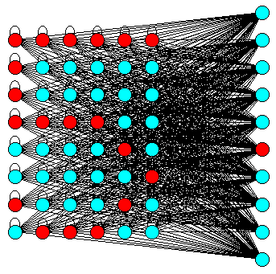
CO636: Cognitive Neural Networks
Lecturer: Professor Howard Bowman

Slide 32
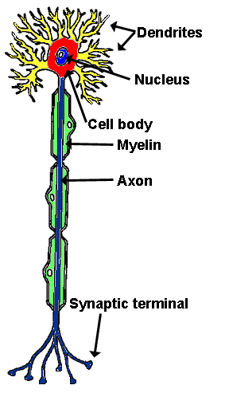
How the brain computes
Electrochemical dynamics of neural circuits
Neurons, synapses, dendrites, axons, etc
Structure of the brain
Activation dynamics,
  excitatory, inhibitory, etc
Types of networks
  feedforward, recurrent, etc

Slide 33
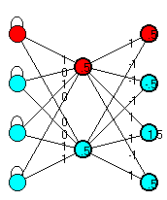
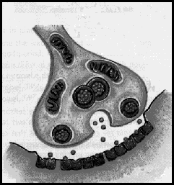
Learning
How do neural systems learn?
How do humans learn?
Change of synaptic efficiency
Types of learning,
  unsupervised
  supervised

Slide 34

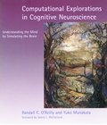
run simulations using PDP++ simulation tool
autumn term: 2 hours of lectures & 2 hours of practicals per week
course text book,
R. O’Reilly & Y. Munakata: “Computational Explorations in Cognitive Neuroscience:
Understanding the Mind by Simulating the Brain” MIT Press, 2000.

Slide 35
CO525
Dynamic Web
◻ CS
☒ CS(AI)
CS(Con)
☑ CS(Net)
☒ CS(Bus)
☒ CSMS
CoBA
☒ WCo
Spring

Slide 36
CO527
Operating Systems & Architecture
☑ CS
☒ CS(AI)
CS(Con)
CS(Net)
☒ CS(Bus)
☒ CSMS
CoBA
☑ WCo
Spring

Slide 37
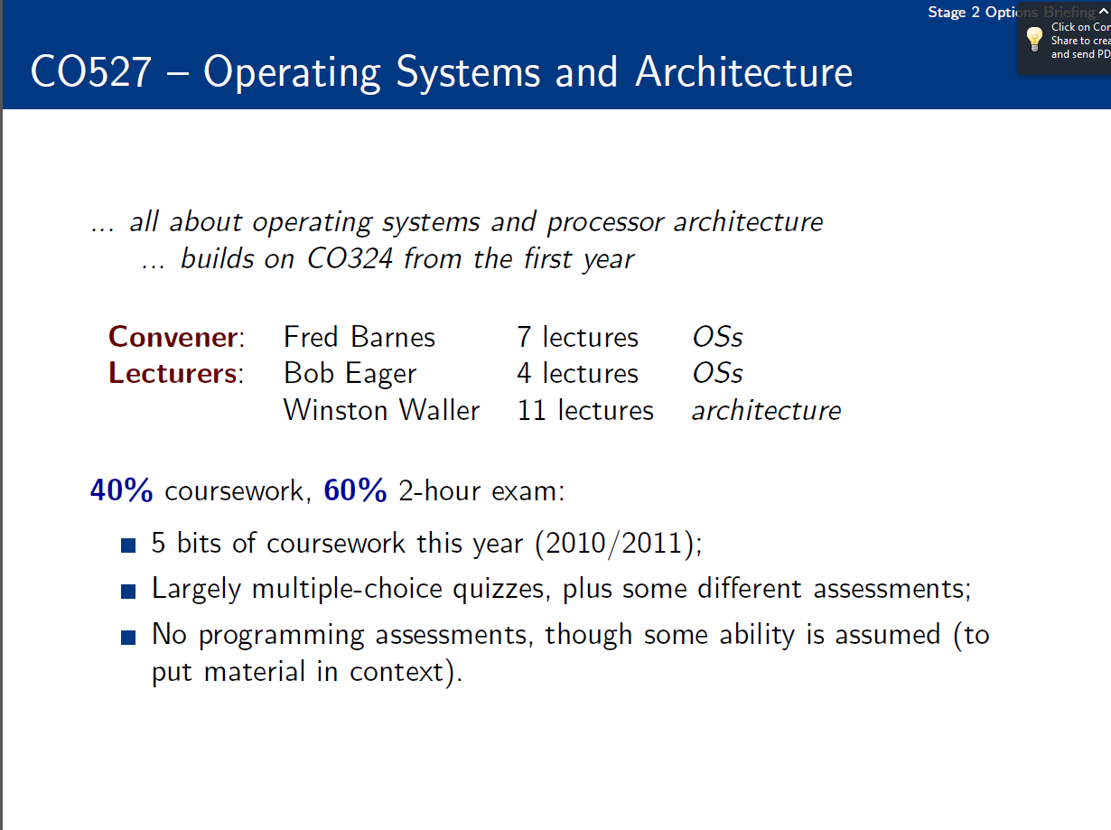

Slide 38
CO528
Introduction to Intelligent Systems
◻ CS
☑ CS(AI)
CS(Con)
☒ CS(Net)
◻ CS(Bus)
CSMS
CoBA
☒ WCo
Spring

Slide 39
CO528: Intro to Intelligent Systems
A broad survey of artificial intelligence and its applications
Topics:
  What is intelligence? How do we test for it?
  How can we turn intelligent action into a computational problem? Search and constraints. Knowledge representation.
  Machine learning. How do we create programs that can generalise from examples?
  How do natural systems exhibit intelligence. Neural networks, swarms, evolutionary computation.

Slide 40
CO532
Database Systems
☑ CS
☑ CS(AI)
CS(Con)
CS(Net)
☑ CS(Bus)
☑ CSMS
CoBA
WCo
Spring

Slide 43
CO536
Advanced Programming Techniques
◻ CS
☒ CS(AI)
CS(Con)
☒ CS(Net)
☒ CS(Bus)
☒ CSMS
CoBA
WCo
Spring

Slide 45
CO537
Functional Programming
☑ CS
☒ CS(AI)
CS(Con)
☑ CS(Net)
◻ CS(Bus)
CSMS
CoBA
WCo
Spring

Slide 46
CO537 Functional Programming
programming based on the mathematical concept of function
a different programming paradigm
in particular: no side-effects
advantages
  smaller programs
  easier reasoning about programs
language we use: Haskell

Slide 47
CO538
Concurrency Design & Practice
◻ CS
☒ CS(AI)
CS(Con)
CS(Net)
☒ CS(Bus)
☒ CSMS
CoBA
WCo
Autumn

Slide 48
(Co538) Concurrency – Design & Practice
Concurrency is the central paradigm for all computer science: multicore processors … robotics … bio-modelling … hard real-time control ... emergent behaviour … internet commerce … supercomputing … mobile agents …
BUT … you have to *love* programming … lots and lots!
Remember the pre-term pre-Stage-1 workshop on concurrent programming of Lego robots?
… it's time to learn and master it! ☺ ☺ ☺
… it's essential for multicore … skills are rare … job market edge!
Concurrent software is traditionally hard: counter-intuitive … the obvious things don’t work … always surprises … only for super-heroes! ☹ ☹ ☹
occam-π
JCSP
Our teaching breaks that tradition: strategic breakthroughs in concurrency research … the obvious things now work. ☺ ☺ ☺
a language for concurrency
a concurrency library for Java

Slide 49
(Co538) Concurrency Fair
Drop-In : 1-3pm, Wednesday, 23rd. March, 2011 : S115B
A showcase (for potential Co538 students) for what’s in the module and its engagement with our research …
Concurrency research staff (faculty, research students, research associates) will be present to explain …
Live demos / videos of student work and research projects (emergent systems, bio-modelling, robotics, etc.) …
Posters, example course material, stuff to take away, …
Mini-presentations (15-20 mins) … repeated on demand … the first one at 1:30 pm … lots of info on Co538 (Moodle).

