Slide 1
Options for Stage 3
18th March 2011

Slide 2
Overview
2 minute sales pitches for options
KITC talk
Projects talk
Questions for convenors
Later Today
14:30-16:00 Project poster fair, Eliot

Slide 3
General Points
Project plus 3 options per term
Online Module registration closes on 1st April
Handbooks have been printed
Some modules have pre-requisites or co-requisites
Cannot choose too many level I modules

Slide 4
Handbook amendment For students on CS(Consultancy)
Page 13
  Students can take either
    CO650
    or
    CO535 and CO645
  Student can NOT take CO600

Slide 5
Options …

Slide 6
Autumn Term
CO529 HCI
CO534 IT Consultancy Methods
CO538 Concurrency Design and Practice
CO633 Computer Networks and Communications
CO634 Computer Security and Cryptography
CO636 Cognitive Neural Networks
CO637 Natural Computation
CB612 New Enterprise Start-Up
EL561 Image Analysis & Applications

Slide 7
Spring Term
CO528 Introduction to Intelligent Systems
CO536 Advanced Programming Techniques
CO639 E-commerce
CO641 Computer Graphics and Animation
CO643 Computing Law & Professional Responsibility
CO646 Computing in the Classroom
CO648 Systems & Services, Design & Management
CO831 Mobile and Ubiquitous Computing
CO832 Data Mining & Knowledge Discovery
PL583 Philosophy of Cog Sci & Artificial Intelligence

Slide 8
Either Term
CO645 IT Consultancy Practice 2
Spanning both Terms
EL667 Embedded Computer Systems
CO600 / CO620 / CO650 Project

Slide 9
CO643
Computing Law and Professional Responsibility
Spring
Notes:
9

Slide 10
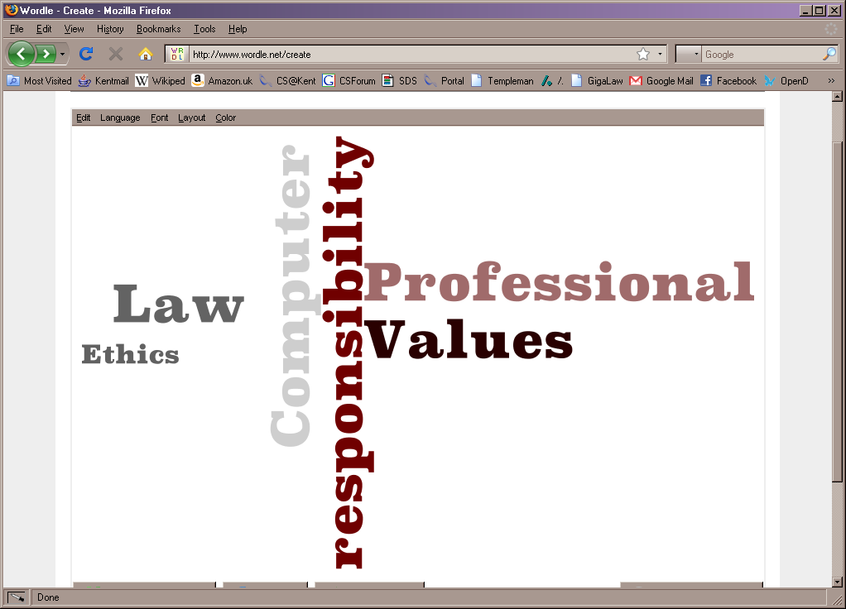
CO643
Computer Law & Professional Responsibility
R.G.Keim@kent.ac.uk
10
Notes:
CO643
R.G.Keim@kent.ac.uk
10

Slide 11
Topics in CO643 include
Professional responsibility topics include
  Codes of ethics
  Professional organisations
  Licensing and certification
  Computer security
  Open source software issues
Legal Topics include
  IPR – Intellectual Property Rights
  Contracts and Licenses
  Liabilities and responsibilities
  Data and privacy
R.G.Keim@kent.ac.uk

Slide 12
What CO643 students do
50% coursework
50% examination
A Textbook to read and use – Computer Ethics and Professional Responsibility
Positive engagement with the material
Through student-led seminars
Through an active lecture/learning environment
R.G.Keim@kent.ac.uk

Slide 13
CO639
E-Commerce
Spring
Notes:
13

Slide 14
CO639 – E-Commerce
Topics
Cryptography
  TLS/SSL, RSA, etc
  Signing documents
Payment processing
Audit Logs
Law
Business considerations
Assessments
Typically include
A1 – Essay
A2 – PHP e-commerce site
Convenor
Gareth Owen
gho@kent.ac.uk

Slide 15
CO529
Human-Computer Interaction
Autumn
Notes:
15

Slide 16
CO529: Human-Computer Interaction
Human-Computer interaction is complex
Involves many areas of study: design, technology, psychology, …
In this module, we study
  How to analyse interaction problems, and then design effective interfaces for computers and similar devices
  How to evaluate an interface, understand its effectiveness, and improve it.
  The research that has been done into effective interface, both looking at specific research and research methods in the area.
Notes:
16

Slide 17
CO633
Computer Networks & Communications
Autumn

Slide 18
CO636
Cognitive Neural Networks
Autumn

Slide 19
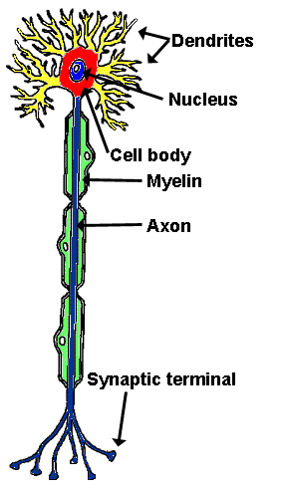
How the brain computes
Electrochemical dynamics of neural circuits
Neurons, synapses, dendrites, axons, etc
Structure of the brain
Activation dynamics,
  excitatory, inhibitory, etc
Types of networks
  feedforward, recurrent, etc

Slide 20
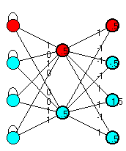
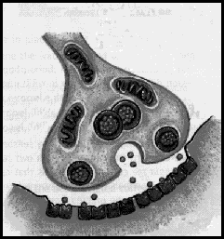
Learning
How do neural systems learn?
How do humans learn?
Change of synaptic efficiency
Types of learning,
  unsupervised
  supervised

Slide 21

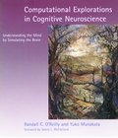
run simulations using PDP++ simulation tool
autumn term: 2 hours of lectures & 2 hours of practicals per week
course text book,
R. O’Reilly & Y. Munakata: “Computational Explorations in Cognitive Neuroscience:
Understanding the Mind by Simulating the Brain” MIT Press, 2000.

Slide 22
Autumn
CO637
Natural Computation

Slide 24
CB612
New Enterprise Start-Up
Autumn

Slide 25
CB612: New Enterprise start-up
KBS contact: Patricia Lewis (P.M.Lewis@kent.ac.uk)
Looking at how a business is started and what makes small businesses succeed.
Practical advice about starting up a business
Aspects: legal, planning, marketing, finance
Main assessment: producing a viable business plan

Slide 26
EL561
Image Analysis & Applications
Autumn
Notes:
26

Slide 27
EL561
Image Analysis & Applications
Images and Image Processing Techniques
  Image representation, analysis and manipulation techniques
Analysing Images
  Pattern recognition and classification techniques
Media Security and Biometrics
  Personal identification techniques and security
Neural Systems Engineering
  Practicalities of building machines which can learn and generalise
Practical laboratories and classes
Notes:
27

Slide 28
CO528
Introduction To Intelligent Systems
Spring

Slide 29
CO528: Intro to Intelligent Systems
A broad survey of artificial intelligence and its applications
Topics:
  What is intelligence? How do we test for it?
  How can we turn intelligent action into a computational problem? Search and constraints. Knowledge representation.
  Machine learning. How do we create programs that can generalise from examples?
  How do natural systems exhibit intelligence. Neural networks, swarms, evolutionary computation.

Slide 30
CO536
Advanced Programming Techniques
Spring

Slide 32
CO641
Computer Graphics and Animation
Spring

Slide 33

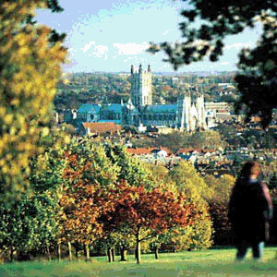
Computer Graphics & Animation
(CO641)
Important for a wide variety of technical and artistic applications including web design, HCI and GUI development, games and simulations, digital photography and cinema, etc...
Module introduces subject from perspective of computing.
Practical assignments on 3D modelling and animation with VRML/X3D and digital imaging with Java.
1) Digital Imaging and Video
Human vision; colour models;
images, video and stereoscopic 3D;
capture and display; resizing;
dithering; contrast enhancement;
storage and communication;
data compression; GIF, JPEG, MPEG.

Slide 34
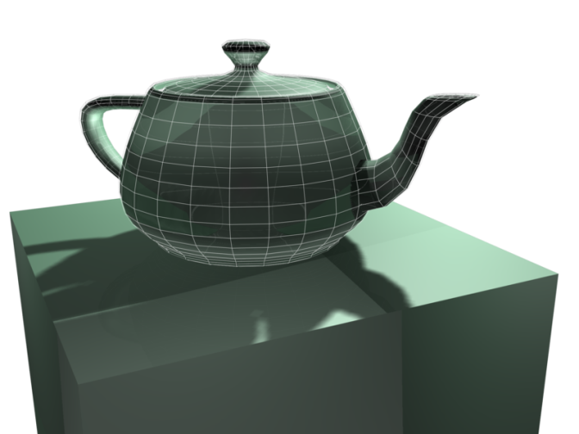
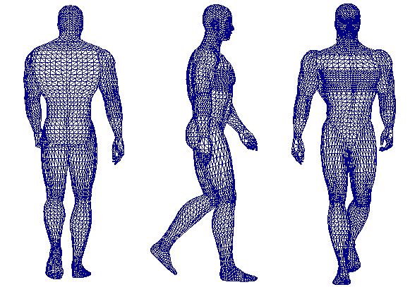
Computer Graphics & Animation
(CO641)
2) Computer Graphics
Graphics pipeline; 3D object and scene modelling with polygon meshes; transformations; VRML/X3D; projection; clipping; visible surface determination; illumination and shading; ray tracing; anti-aliasing.
3) Computer Animation
Key-frame animation; interpolation;
warping and morphing; articulated figures; kinematics; dynamics; collision detection; particle systems; video-realism; computer-generated human characters.

Slide 35
CO646
Computing in the Classroom
Spring
Notes:
35

Slide 36

CO646 Computing in the Classroom
Module subject to quota/interview
Learn how to teach computing…
… then put it into practice
  ten half-day visits to a local school
  observe and help with computing teaching
Assessment
  devise an original project then implement and evaluate it in the school
  reflective writing on your experience in the school

Slide 37
CO648
Systems and Services, Design and Management
Spring

Slide 38
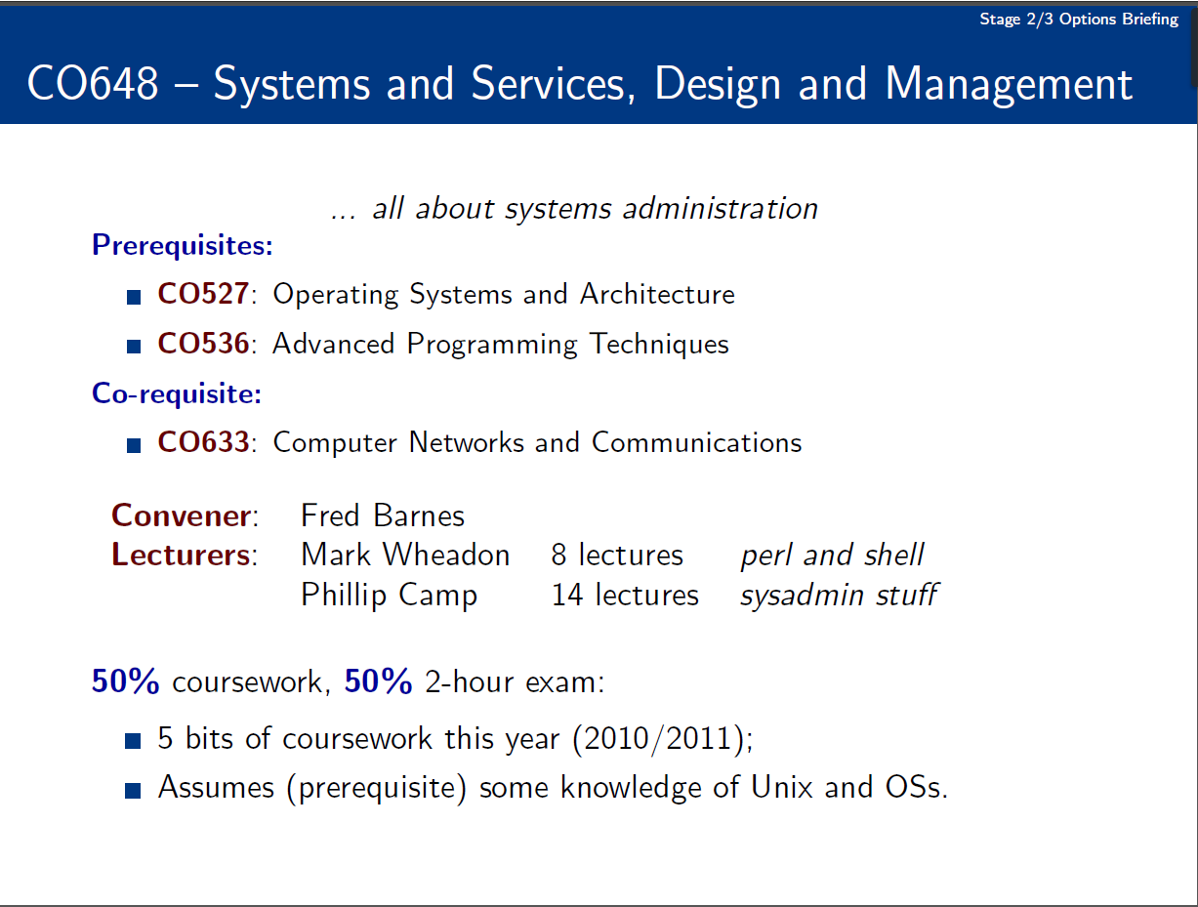

Slide 39
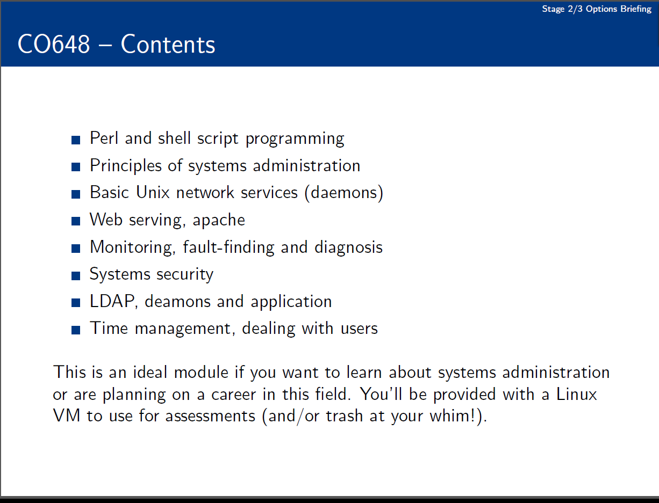

Slide 40
CO831
Mobile and Ubiquitous Computing
Spring

Slide 43
CO832
Data Mining & Knowledge Discovery
Spring
Notes:
43

Slide 44
CO832 - Data Mining and Knowledge Discovery
Data Mining consists of extracting knowledge from data
We will study data mining techniques based on machine
learning (a branch of AI) and statistics (probabilities)
size value
decision
knowledge
information
data
DM
DBMS
This is a research-oriented module

Slide 45
CO634
Computer Security & Cryptography
Autumn

Slide 47
CO634 Computer Security and Cryptography
A 2-hour exam worth 70%
Assessments worth 30%
  2 assessments, worth 15% each
Pre-requisites
  CO324 Computer Systems
  CO526 Distributed Systems and Networks
  CO527 Operating Systems and Architecture

Slide 48
PL583
Philosophy of Cognitive Science & Artificial Intelligence
Spring
Notes:
48

Slide 49
PL583
Philosophy of Cog Sci & AI
Double module!
Considers issues about whether machines can be intelligent, and looks at various aspects of AI from a philosophical perspective.
100% coursework
Quota
Notes:
49

Slide 50
EL667
Embedded Computer Systems
Both
Notes:
50

Slide 51

EL667 – Embedded Computer Systems (CS & CSE)
Embedded Computer Systems are everywhere!
  Mobile Phones, DVD Players, Motor Vehicles…
All are based on an embedded microcomputer running a real time operating system.
This module covers Hardware and Software design for Embedded Systems and Real Time Operating Systems.
Based on real Case Studies
Includes a 1-day lab class – Engine Management Simulator.
Notes:
51

Slide 52
CO538
Concurrency: Design & Practice
Autumn

Slide 53
(Co538) Concurrency – Design & Practice
Concurrency is the central paradigm for all computer science: multicore processors … robotics … bio-modelling … hard real-time control ... emergent behaviour … internet commerce … supercomputing … mobile agents …
BUT … you have to *love* programming … lots and lots!
Remember the pre-term pre-Stage-1 workshop on concurrent programming of Lego robots?
… it's time to learn and master it! ☺ ☺ ☺
… it's essential for multicore … skills are rare … job market edge!
Concurrent software is traditionally hard: counter-intuitive … the obvious things don’t work … always surprises … only for super-heroes! ☹ ☹ ☹
occam-π
JCSP
Our teaching breaks that tradition: strategic breakthroughs in concurrency research … the obvious things now work. ☺ ☺ ☺
a language for concurrency
a concurrency library for Java

Slide 54
(Co538) Concurrency Fair
Drop-In : 1-3pm, Wednesday, 23rd. March, 2011 : S115B
A showcase (for potential Co538 students) for what’s in the module and its engagement with our research …
Concurrency research staff (faculty, research students, research associates) will be present to explain …
Live demos / videos of student work and research projects (emergent systems, bio-modelling, robotics, etc.) …
Posters, example course material, stuff to take away, …
Mini-presentations (15-20 mins) … repeated on demand … the first one at 1:30 pm … lots of info on Co538 (Moodle).

