Slide 1
Parametric Prediction of Heap Memory Requirements
Víctor Braberman, Federico Fernandez, Diego Garbervetsky, Sergio Yovine*
Departamento de Computación
Facultad de Ciencias Exactas y Naturales
Universidad de Buenos Aires (UBA)
(*) VERIMAG, France. Currently visiting UBA.
Notes:
Hello, I’m Diego Garbervetsky from University of Buenos Aires. This a joint work with Victor Braberman, Federico and Sergio Yovine that we call “Parametric specificactions of dynamic memory Requirements”.

Slide 2
Motivation
Context: Java like languages
  Object orientation
  Automatic memory management (GC)
Predicting amount of memory allocations is very hard
  Problem undecidable in general
    Impossible to find an exact expression of dynamic memory requested, even knowing method parameters
Predicting actual memory requirements is harder
  Memory is recycled
    Unused objects are collected
    ⇒ memory required <= memory requested/allocated
Notes:
We are interested in working with Java likes languages which provides several advantages such us Object orientarion and specially automatic memory management which takes cares of the deallocation of unused objects. This kind of features make program development easier and less error-prone.
However, in this setting where objects are allocated dynamically predicting memory utilization is very dificult. In fact, just predicting memory allocations is hard, indeed is undecidable. In fact, it is a problem similar to the halting problem assuming that every program statement consumes some amount of memory.
Even harder is predicting actual memory requirements, taking into account that memory can be reused once unused objects are collected by the GC.

Slide 3
Example
How much memory is required to run m0?
m0(2)
void m0(int mc) {
1: m1(mc);
2: B[] m2Arr=m2(2 * mc);
}
void m1(int k) {
3: for (int i = 1; i <= k; i++){
4: A a = new A();
5: B[] dummyArr= m2(i);
}
}
B[] m2(int n) {
6: B[] arrB = new B[n];
7: for (int j = 1; j <= n; j++) {
8: arrB[j-1] = new B();
9: C c = new C();
10: c.value = arrB[j-1];
}
11: return arrB;
}
ret m1
m0(7)
ret m1
Notes:
Thus, look at the following code. It basically allocates several objects in the body of two loops. For instance, when method m0 calls m1 allocates k objects of type A and then makes several calls method m2 which allocates n objects of type B and C and an array of type B.
Later, m0 calls again m2.
The pictures on the right show the memory consumption of two different executions of the same program using a sort of “ideal” GC which releases the objects when they are not longer reacheable.
The amount of memory required for this program depends on the parameter “mc” which is m0’s parameter. Notice that that not only the amount of memory of the peak consumption of the program changes when mc changes, also the place where this peak is reached also changes according to the calling context.

Slide 4
Our goal
  An expression over-approximating the peak amount of memory consumed using an ideal memory manager
    Parametric
    Easy to evaluate
      E. g. :Required(m)(p1,p2) = 2p² + p1
    Evaluation cost known “a priori”
Given a method m(p₁,..,p_{n})
peak(m): an expression in terms of p₁,…,p_{n} for the max amount of memory consumed by m
Notes:
Our goal is to obtain an expression that overapproximates peak memory consumption. We want the expression to be in terms of the method under analysis’ parameters.
We also want the expression to be easy to evaluate. That means, the evaluation cost has to be low or are least known before.
In this work we propose a technique to obtain such expression. That is, given a method we obtain a parametric expression overapproximating the maximum amount of memory consumed by any run starting at m.

Slide 5
Context
Previous work
  A general technique to find non-linear parametric upper- bounds of dynamic memory allocations
    totAlloc(m) computes an expression in terms of m parameters for the amount of dynamic memory requested by any run starting at m
    Relies on programs invariants to approximate number of visits of allocating statements
  Using a scope-based region management…
    An application of that technique to approximate region sizes
Notes:
In a previous work, we propose a technique to over-approximate the amount of memory requested by a method or program during its execution.
We also presented an application of his technique in the context of scoped memory management where we are able to synthesize regions sizes in terms of the parameters of the associated method.

Slide 6
Computing dymamic memory allocations
Basic idea: counting visits to memory allocating statements.
for(i=0;i<n;i++)
for(j=0;j<i;j++)
    new C()
φ ≡{0≤ i < n, 0≤j<i}: a set of constraints describing a iteration space
Dynamic Memory allocations ≅ number of visits to new statements
≅ number of possible variable assignments at its control location
≅ number of integer solutions of a predicate constraining variable assignments at its control location (i.e. an invariant)
j
For linear invariants, # of integer solutions = # of integer points = Ehrhart polynomial size(B) * ( ½k2+½k)
i
Notes:
The key idea behind our previous work is relating dynamic memory allocations with visits to new statements.
We relate the number of visits to a statement to the number of possible variable assignments in the control location of that statement.
This can be related to the number of solutions of an invariant constraining variable assignments for this control location.
And if the invariant contains linear constraints this can be expressed as the number of integer points of a polyhedron.
And fortunately, there is a technique that generates an ehrhart poyinomial representing this number of integer points.

Slide 7
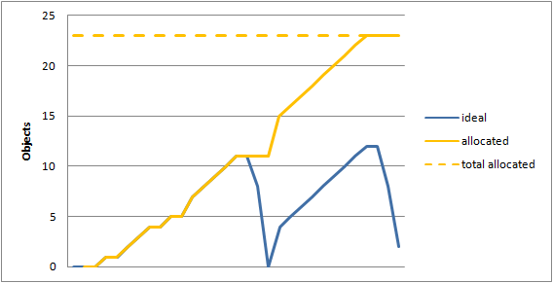
Memory requested by a method
  How much memory (in terms of m0 parameters) is requested/allocated by m0
totAlloc(m0)(mc) =
= (size(B[])+size(B)+ size(C))(1/2 mc² +5/2 mc) +size(A)mc
Notes:
For instance we can synthesize the following expression approximating the total amount of dynamic memory allocated by m0.
However, this expression is too conservative if we want to predict actual memory requirements since object deallocation is not taking into account.

Slide 8
Problem
Memory is released by a garbage collector
  Very difficult to predict when, where, and how many object are collected
Our approach: Approximate GC using a scope-based region memory manager
m0(2)
m0(7)
Notes:
The problem is that is it diffcult to predict when objects are actually realeased by the GC and it is even more complicate to know how many objects.
Thus, our approach is to approximate an ideal GC using a more coarse grained one based on memory regions.

Slide 9
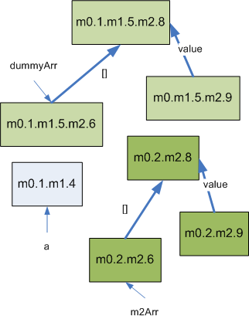
Region-based memory management
Memory organized using m-regions
void m0(int mc) {
1: m1(mc);
2: B[] m2Arr=m2(2 * mc);
}
void m1(int k) {
3: for (int i = 1; i <= k; i++){
4: A a = new A();
5: B[] dummyArr= m2(i);
}
}
B[] m2(int n) {
6: B[] arrB = new B[n];
7: for (int j = 1; j <= n; j++) {
8: arrB[j-1] = new B();
9: C c = new C();
10: c.value = arrB[j-1];
}
11: return arrB;
}
Notes:
Volvamos a nuestro ejemplo. El grafico muestra un grafo que aproxima las referencias entre objetos que crea este programa.
Cada nodo en este grafo representa todos los objetos que pueden crearse en ese punto. Hay tantos nodos como creation sites.

Slide 10
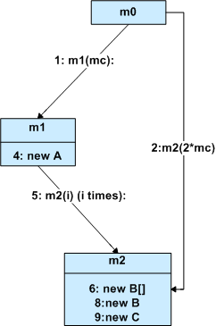
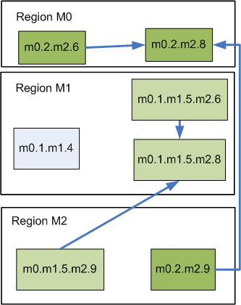
Region-based memory management
Memory organized using m-regions
Notes:
In this case we define a memory manager where there is one region associated within each method. So, the lifetime of objects in a region is directly associated with the lifetime of the associated method.
For instance, for our example we can make this region organization. Boxes represents creation sites that are an abstraction of all objects creating in a program location. Ligth green boxed corresponds to objects created in method m2 but following the call chain that passes from m1 and the dark green corresponds to objects from m2 when it is called directly from m0.
To respect scoping rules, object has to be allocated in the region that has a lifetime equal or longer to the object lifetime.
In this case, objects refer to objects in the same region or to objects with a longer lifetime.

Slide 11
Region-based memory management
Escape Analysis
Escape(m): objects that live beyond m
  Escape(mo) = {}
  Escape(m1) = {}
  Escape(m2) = {m2.6, m2.8}
Capture(m): objects that do not live more that m
  Capture(mo) = {m0.2.m2.6, m0.2.m2.8},
  Capture(m1) = {m1.4, m0.1.m1.5.m2.6, m0.1.m1.5.m2.8},
  Capture(m2) = {m2.9}
Region(m) ≅ Capture(m)
void m0(int mc) {
1: m1(mc);
2: B[] m2Arr=m2(2 * mc);
}
void m1(int k) {
3: for (int i = 1; i <= k; i++){
4: A a = new A();
5: B[] dummyArr= m2(i);
}
}
B[] m2(int n) {
6: B[] arrB = new B[n];
7: for (int j = 1; j <= n; j++) {
8: arrB[j-1] = new B();
9: C c = new C();
10: c.value = arrB[j-1];
}
11: return arrB;
}
Notes:
Thus, to sinthesize memory regions we use escape analysis as a way to approximate object lifetimes.
Basically, the region of each method is composed by the creation sites that do not escape the method but escape from some of its callees.

Slide 12
Obtaining region sizes
Region(m) ≅ Capture(m)
memCap(m): an expression in terms of p₁,…,p_{n} for the amount of memory required for the region associated with m
memCap(m)is totAlloc(m)applied only to captured allocations
memCap(m0) = (size(B[]) + size(B)).2mc
memCap(m1) = (size(B[]) + size(B)).(1/2 k² +1/2k) +size(A).k
memCap(m2)= size(C).n
Notes:
Method’s associated regions can be sinthesize using escape analysis.
Thus, we can adapt our technique that compute total allocations to consider only the creation sites caputed by the method under analysis.
Using this approach we are able to obtain parametic expressions that overapproximate region sizes.

Slide 13
Approximating peak consumption
Approach:
Over approximate an ideal memory manager using an scoped-based memory regions
  m-regions: one region per method
When & Where:
    created at the beginning of method
    destroyed at the end
How much memory is allocated/deallocated in each region:
    memCap(m) >= actual region size of m for any call context
How much memory is allocated in outer regions :
    memEsc(m) >= actual memory that is allocated in callers regions
Notes:
Ok… we can model a memory manager using a scoped-based region manager, sinthesize memory regions and compute its sizes.
In fact, using a similar reasoning, we can also compute the amount of memory escaping a method.
We will use all this information to model peak memory consumption under this setting….

Slide 14
Approximating peak consumption
Peak(m) = Peak↑(m) + Peak↓(m)
  peak↑(m): peak consumption for objects allocated in regions created when m is executed
  peak↓(m): consumption for objects allocated in regions that already exist before m is executed
Our technique:
mem ↑(m) >= Peak ↑(m)
  Approximation of peak memory allocated in newly created regions
mem↓(m) >= Peak↓(m)
  Approximation of memory allocated in preexistent regions (memEsc(m))
m callees’ regions
m region
Pre existent regions
Notes:
Suposse, we want to analyze peak consumption of a method m. When “m” is executed a region for “m” will be created and also a region for each method that m calls. During the execution of those methods, some objects will be allocated in one of the newly created regions or if they lifetime exceed method “m” lifetime they will be allocated in a preexistent region.
So, when computing the peak consumption for m we will distinguish between the maximum consumption produced in newly created regions from the consumption produced in already existent regions.
Using that approach, we focus on a technique to produce an overapproximation of the peak amount of memory consumed by newly created regions. The approximation of the consumption for the pre-existent regions can be done using the estimation of the amount of memory escaping the method under analysis.

Slide 15
Approximating Peak↑(m)
  Region’s stack evolution
Some region configurations can not happen at the same time
?
rm2
rm2
rm1
rm1
rm1
rm1
rm1
?
rm2
?
rm0
rm0
rm0
rm0
rm0
…
rm0
rm0
rm0
?
peak↑(σ₀, m0) = max Σ size(r_{k}(σ))
Notes:
So what happens with the regions created by the method under analysis?
This is how memory regions evolves following the execution of the methods. Observe that the maximum number of active regions is bounded by the size of the maximum path is the call graph.
Thus, the maximum consumption of newly created region can be computed by taking the region configuration whose sum of region sizes is the largest one. The problem is that number of configurations can be infinite…
and of course every region size depends on the state of the program when the associated method is called and

Slide 16
Approximating Peak↑(m)
  Region sizes may vary according to method calling context
rsize(m2) = n (assume size(C)=1)
m0.1.m1.5.m2
  { k= mc, 1≤i ≤k, n = i}
  { k= mc = n} maximizes
  maxrsize(m0.1.m1.5.m2,m0) = mc
rm2
rm2
rm2
In terms of m0 parameters!
rm1
rm1
rm1
…
rm0
rm0
rm0
peak↑(m0)
Notes:
We want to get rid of this dependency on program states. For that, we can use a region size specification for a method which can be computed for instance using our previous work of specified by the developer…
Notice also in every configuration the number of regions is fixed and what change are their sizes.
For instance, we can analyze the evolution of regions for m2 when it is called from m1.
m1 has a loop which calls several times m2. At each iteration the size of the region for m2 changes according to the calling context, in this case the value assigned to the parameter “n”.
Notice, that the value this parameter “n” is indeed constrained by the value of the parameter “mc” from method m0 which determines the potential values of parameter “k” which determines the values of “i” argument used to call m2.
We model the calling context using a binding invariant which represent the possible variable assigments in this context.
We can approximate a set of region configurations within a calling context by considering the one with the largest region size.
We denote this maximum as “maxrsize”. In this case the largest region for m2 is produced when n is equal to mc.
We want to express this expressions in terms of the root method parameters in order to able to compare it with other regions sizes later.

Slide 17
Approximating Peak↑(m)
  We consider the largest region for the same calling context
peak↑(m0) ≤
= mem↑(m0)
m0.1.m1.5.m2
maxrm2
m0.1.m1.5
m0.2
maxrm1
maxrm1
maxrm2
m0
maxrm0
maxrm0
maxrm0
maxrm0
mem↑(m0)
Notes:
As a consequence, we can approximate the peak consumption by considering only one representative configuration per calling context. The potential calling contexts can be approximated using paths in the call graph and binding invariants.
This representative contains the largest region sizes for that call chain.
Notice that this decision lead to an over-approximation because it can be the case that two regions for two different methods cannot reach their maximum in the same calling context.
Notice also that, if the program is not recursive, the number of elements to compare for the max computation is finite.
Es importante aclarar que esta decision implica sobre aproximar, ya que puede pasar que para una configuración NO pueda darse nunca que las regiones adquieran su maximo valor al mismo tiempo.

Slide 18
Approximating Peak↑(m)
3. Maximizing instantiated regions
maxrsize(π.m,m0)(P_{m0})
= Maximize rsize(m) subject to I_{π}(P_{m0} ,P_{m,} W)
We cannot solve a non-linear maximization problem in runtime!!
  Too expensive
  Execution time difficult to predict
We need a parametric solution that can be solved at compile time.
m-region expressed in terms of m parameters
  rsize(m2)(m0) = n
Maximum according to calling context and in terms of MUA parameters
  maxrsize(m0.1.m1.5.m2,m0) (mc) = mc
  maxrsize(m0.2.m2,m0)(mc) = 2mc
Notes:
Thus, the most important problem now is to compute the largest region size for a given calling context. In particular we need an expression representing the largest size a region for a method m can reach when called from a method under analysis (in this case m0) using a particular calling context given by the call chain leading to m.
The calling context will be given by a binding invariant and the region size is a function of its associated method parameters.
Remenber that we already have a method to approximate region sizes. We can use that methods or provide this specifications by other means.
Since our technique is able to provide polynomials in terms of the associated method parameters, we are dealing with a non-linear optimization problem.
Non-linear optimization problems are hard to solve and its execution time is difficult to predict. Thus, we cannot solve this problem in runtime. We need to solve this in compile time.
This makes the problem even more complicated because we need a parametric solution that can be instantiated when parameter values are known in runtime.

Slide 19
Solving maxrsize
Solution: use an approach based on Bernstein basis over polyhedral domains (Clauss et al. 2004)
  Enables bounding a polynomial over a parametric domain given as a set of linear restraints
  Obtains a parametric solution
Bernstein(pol, I):
  Input: a polynomial pol and a set of linear (parametric) constrains I
  Return a set of polynomials (candidates)
    Bound the maximum value of pol in the domain given by I
Notes:
Lukelly, there is a solution to this problem. This solution is due to Clauss wich extend an original technique of Bernstein to bound polynomials. The technique of Clauss receives a polynomial and a domain expressed as a polytype produces a set of polynomials wich are candidates of the maximun and minimum bound of the input polynomial within that given domain.

Slide 20
Solving maxrsize using bernstein
Example:
Input Polynomial
  Q(n)=n²-1,
Restriction: A parametric domain (linear restraint)
  D(P1,P2) = {(i, n) |1 ≤i≤P1 +P2, i ≤ 3P2, n=i}
Bernstein(Q, D) =
  D1 = {P1≤2P2} C1: {(P1+P2)²-1,P2+P1 }
  D2 = {2P2≤P1} C2: {9P2²-1}
Partial solution to our problem
  We still need to determine symbolically maximum between polynomials
  In the worst case we can leave it for run-time evaluation (cost known “a priori”)
    A comparison when actual parameters are available
Notes:
For instance, consider the following polynomial and domain and a set of parameters. Berstein applied to this polinomial returns the following two set of candidates determined for a parametric domain.
Notice that the result is in terms of the set of selected parameters.
This is a remarkable feature of this symbolic technique: the result is a parametric expression which doesn’t have to be in terms of the parameters of the input polynomial.
However, notice that there are still some problems: the output is not a simple expression, it is a set of candidates polynomails that need to evaluated to determine which is the largest one. This set can be reduced by applying some symbolic techniques or it can be done directly in run-time. In any case the evaluation cost is known “a priori”

Slide 21
maxrsize
max { q(P_{mo}) ∈ C1} if D1(P_{mo})
Maxrsize(m0,π.m_{k})=
  max { q(P_{mo}) ∈ Ck} if Dk(P_{mo})
  where {Ci, Di} = Bernstein(rsize(m_{k}), I _{π.mk},P_{m0})
Maxrsize(m0,m0)(mc) = (size(B[]) + size(B)).2mc
Maxrsize(m0.1.m1,m0)(mc) =
(size(B[]) + size(B)).(1/2 mc² +1/2mc) +size(A).mc
Maxrsize(m0.1.m1.5.m2,m0)(mc) = size(C).mc
Maxrsize(m0.21m2,m0)(mc) = size(C).2mc
Notes:
Thus, if we can describe binding invariants using linear constrains and region sizes using polynomails, we can use this technique to compute maxrsize.
For our example we can produce the following expressions which are in terms of method m0 parameters although region sizes are expressed in terms of their method parameters. Now, the whole problem is now reduced to max comparison between polynomial in terms of the same parameters.
This variable renaming can be performed thanks to the Bernstein transformation and because the invariant binds the parameters of method under analysis with the parameters of the method from which we want to perform the maximization.

Slide 22
Evaluating mem↑
mem↑:
  basically a sum maximized regions
  A comparison of the results of the sum
m0.1.m1.5.m2
m0.1.m1.5
maxrm2
m0.2
maxrm1
maxrm1
maxrm2
m0
maxrm0
maxrm0
maxrm0
maxrm0
max
Notes:
So far approximate the peak consumption, considering the sum of largest region of every region configuration among the possible call chains leading from the methdo under analysis
Notice that is not n

Slide 23

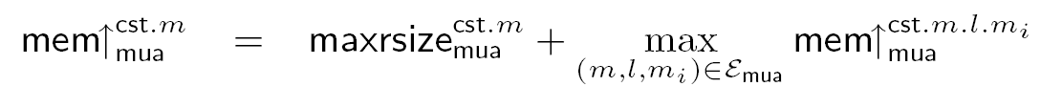
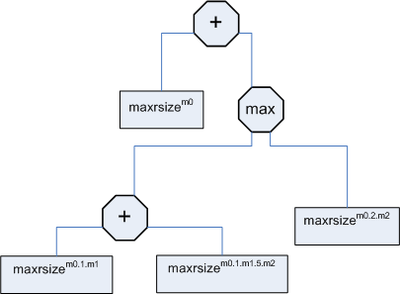
Evaluating mem↑
rm0
rm1
rm2
rm2
Notes:
Instead of comparing the region configurations for all paths in the program, we can compute recursively the same maximum by traversing the call graph en genereting an evaluation tree whose leaves are non-linear maximization problems and the nodes are summing or max operations. Max is used for branches in the call graph and sums when we go deeper to generate a region configuration.

Slide 24
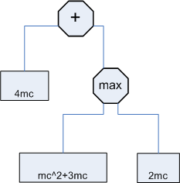
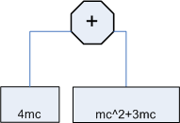
Manupilating evaluation trees
Considering size(T) = 1 for all T
Notes:
We can try to simplify offline the tree until we get an expression that we cannot or we don’t want to simplify. This evaluation tree can be then translated into code that can be executed when the parameters becomes available.

Slide 25
Dynamic memory required to run a method
Computing memReq
Memreq_{m0}(mc) = mc² +7mc
Notes:
For instance, for our example we can compute the following expression for the peak consumption of method m0.
If we analyze the peak consumption using a more ideal GC we see that we are over-approximating.
Nevertheless, once we assume our region based memory manager the obtained expression is quite accurate.

Slide 26
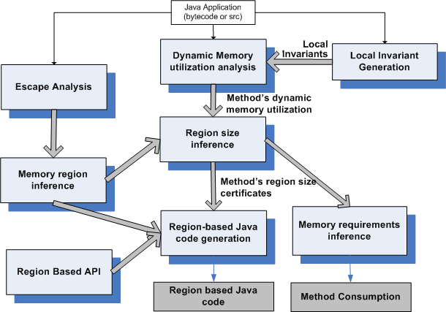
The tool-suite
Notes:
We integrated this technique into a tool that is able to compute total allocations and region sizes and also generate region base code out-of conventional java code by sinthesizing the memory regions using escape analysis.

Slide 27
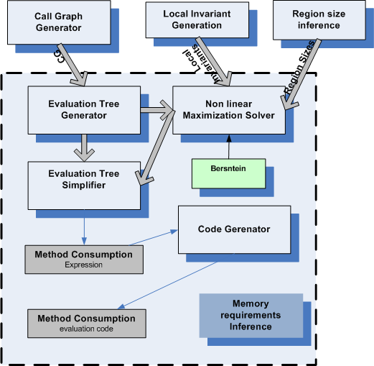
Peak memory computation component
Experimentation (#objects)
Jolden: totAlloc vs Peak vs region based code
MST, Em3d completely automatic
For the rest we need to provide some region sizes manually
MST, Em3d, Bisort, TSP: peak close to totAlloc (few regions, long lived objects)
Power, health, BH, Perimeter: peak << totAlloc
Notes:
Let me show you a detailed view of the componentes that implements the technique.
The technique relies on having a call graph of the application to generate the potential memory regions configurations and a component that provides invariants which are used as binding invariants when we model the non-linear maximization problem of obtaining largest region sizes. As we mention this problem is solved using a technique based on the bersntein transfomation. The peak consumption solution is modeled as an evaluation tree wich can be simplified (if it is possible) and it is used to produce code that can be evaluated in runtime.

Slide 28
Experiments (#objects)
Notes:
Indicar que en el caso de Bisort la sobreaproximación viene de que el tamaño de la region esta determinado por la potencia mas grande que es menor o igual al parametro
MST, Em3d, Bisort, TSP , Power, health, BH, Perimeter

Slide 29
Related work
Author | Year | Language | Expressions | Memory Manager | Benchmarks
Hofmann & Jost | 2003 | Functional | Linear | Explicit | No
Lui & Unnikrishnan | 2003 | Functional | Recursive functions | Ref. Counting | Add-hoc (Lists)
Chin et al | 2005 | Java like | Linear (Pressburger): Checking | Explicit | Jolden
Chin et al NEXT PRESENTATION! | 2008 | Bytecode | Linear: Inference | Explicit | SciMark, MyBench
Albert et al (2) | 2007 | Bytecode | Recurrence equations | No && Esc Analysis | No
Notes:
We found that research on dynamic memory consumption inference or verification has becoming more active in the last 5 or 6 year possibly related with the aim of using automatic memory management for embedded systems and still having guaranties of not getting out of memory errors…
Now I will hightlight the related works we found more relevant. Hofmann and Jost proposed a technique for inferring linear bounds for funcional languages. It is based on type derivation and linear programming using an explictic deallocation mechanism.
Lui and collaborators present a technique also for functional languages which basically produces a new function that mimics the behavior of the original function but computes its consumption. The function codifies a reference counting GC to release ununsed objects. One problem with this technique is that the evaluation of the bound function cannot terminate even if the original does.
The people who are going to present the next paper presented before a technique to check resource allocations contracts written using Pressburger predicates for a java like program using annotations for specifiyng aliasing and uniques properties. Today they will present a technique also to infer memory consumption specifications.
Albert and colaborators presents and technique to infer dynamic memory allocations based in their frame work for cost analysis which produces recurrence equations modeling the complecity of a piece of code. This equation may be hard to evaluate although they recently present a work about how to get bounds from those equations.
In a second work presented last year in this conference they also propose a way to consider deallocation using escape analysis. Although they present some benchmarks for the first technique they do not present new experimention showing how the effect of escape analysis in the sinthesis of specifications.

Slide 30
Conclusions
A technique for computing parametric (easy to evaluate) specifications of heap memory requirements
  Consider memory reclaiming
  Use memory regions to approximate GC
  A model of peak memory under a scoped-based region memory manager
  An application of Bernstein to solve a non-linear maximization problem
  A tool that integrates this technique in tool suite
Precision relies on several factors:
  invariants, region sizes, program structure, Bernstein
Notes:
Concluding, we developed a technique to infer parametric and easy to evaluate specification of heap memory requirements.

Slide 31
Conclusions
Future work
Restrictions on the input
  Better support for recursion
  More complex data structures
  Other memory management mechanisms
Usability / Scalability
  Integration with other tools/ techniques
    JML / Spec# (checking+inferring)
    Type Systems (Chin et al.)
    Modularity
  Improve precision

