Slide 1

#errordiary
www.errordiary.org
Sarah Wiseman, Sandy Gould, Dom Furniss & Anna Cox
UCL Interaction Centre
Notes:
Novel tool to collect errors

Slide 2


The study of error
Notes:
Taught as a topic on ACS – applied cog sci.
Gateway topic that introduces students to UCLIC research
An area in which we use both Lab results, and real world data

Slide 3

Diary Studies
Notes:
Early work involved diary studies – asking people to note down when they made an error

Slide 4
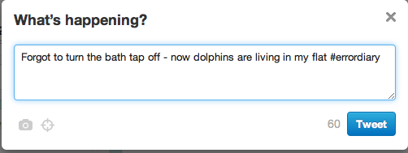
#errordiary
Notes:
Errordiary is a modern day equivalent.
Ask people to tweet errors using the errordiary hashtag

Slide 5
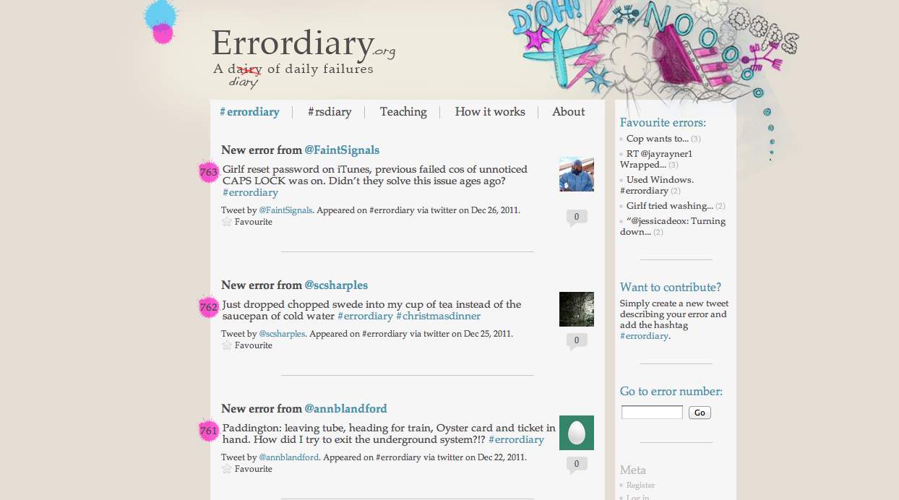
www.errordiary.org
Notes:
We have an accompanying website that collates all the tweets.
Also provides the opportunity for people to comment on tweets

Slide 6
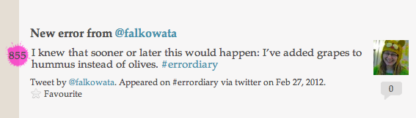
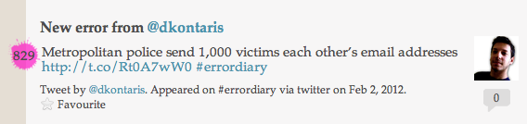
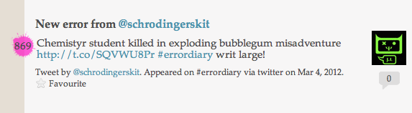
Funny, Frustrating, Fatal
Notes:
What do we collect with error diary?

Slide 7
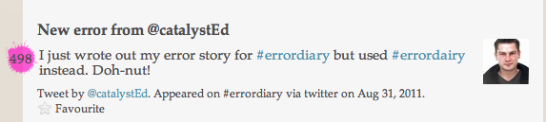
Notes:
Early days – errordairy
We now are all a lot more careful when typing diary now

Slide 8
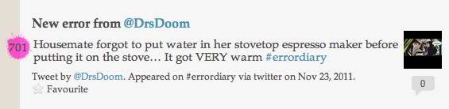
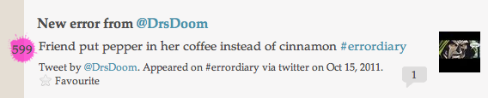
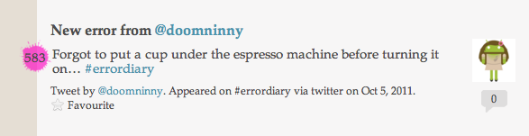
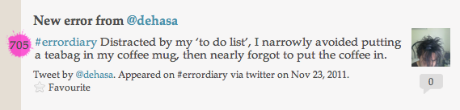
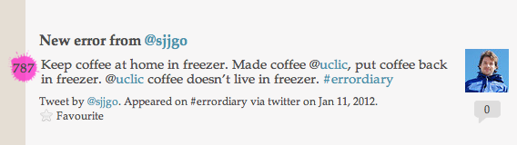
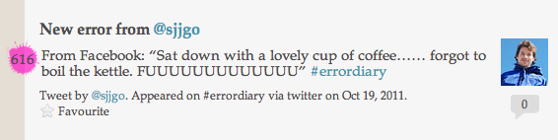
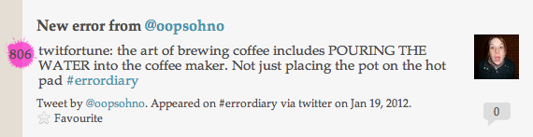
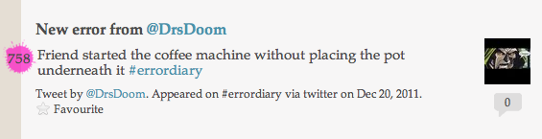
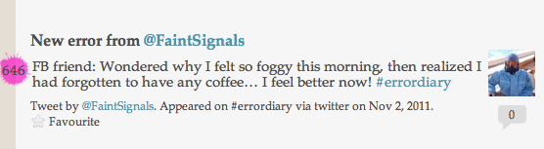
Coffee

Slide 9
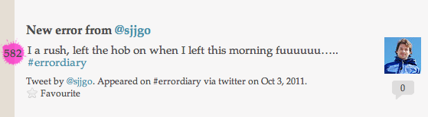
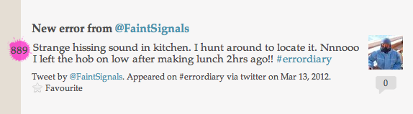
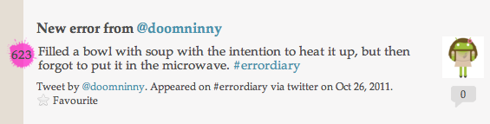
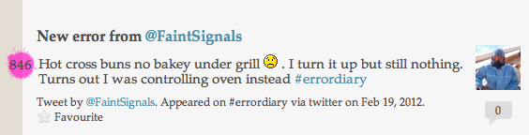
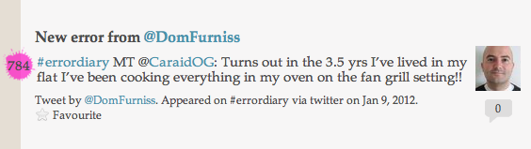
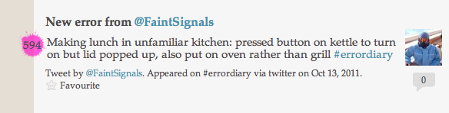
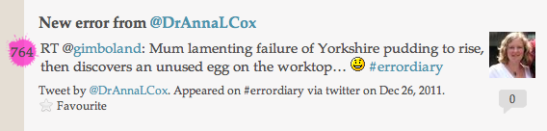
Making food

Slide 10
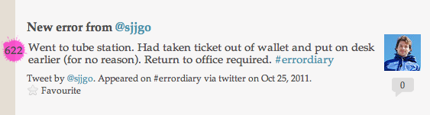
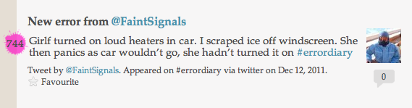
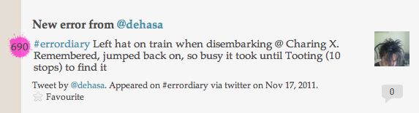
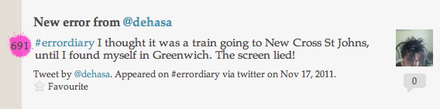
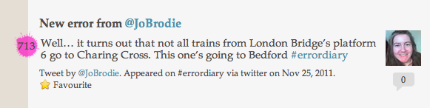
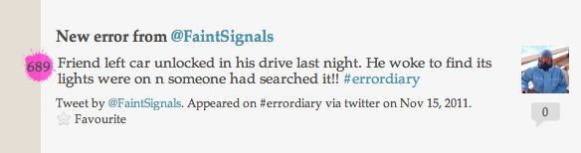
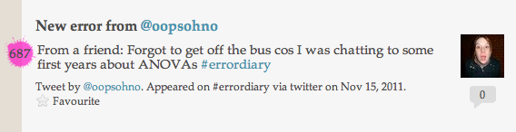
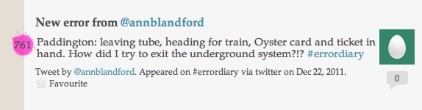
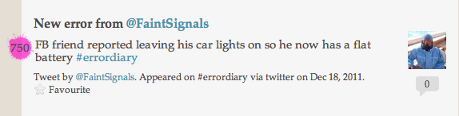
Travel

Slide 11
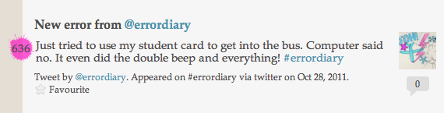
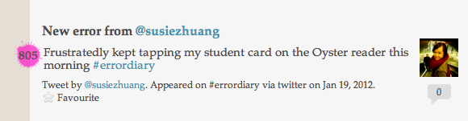
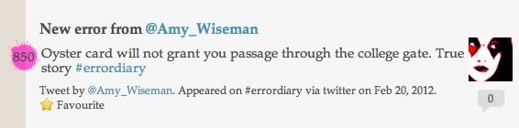
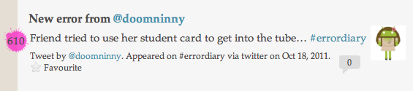
Oyster/Student card

Slide 12
Funny, Frustrating, Fatal
Notes:
Aside from realising we should all stop cooking things and hook academics up with caffeine drips to avoid coffee catastrophe
What can we actually do with these errors?
Previous examples, all examples of perceptual slips….demonstrate that it is the same mechanism underlying trivial and fatal human error stories

Slide 13
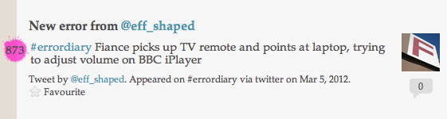
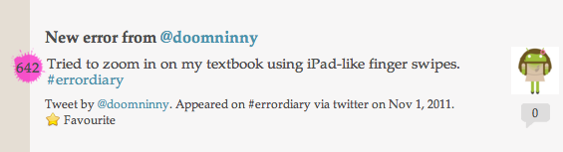
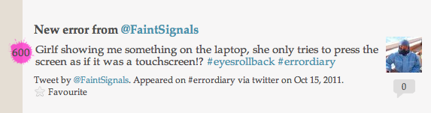
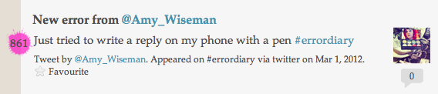
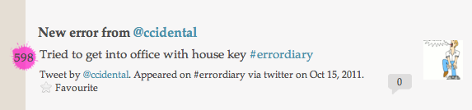
Description error
Notes:
Description slips, using a familiar action on an incorrect item

Slide 14
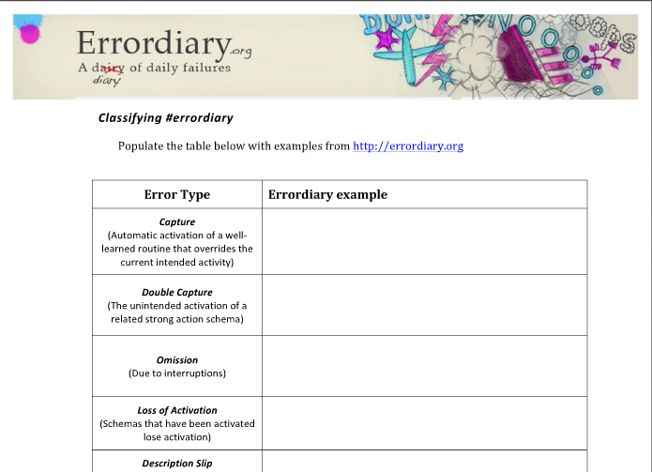
Use in Teaching
Notes:
Ask the students to classify the errors according to Norman’s Action Cycle (underlying cause)
=> Important to choose carefully => Real world data is messy => it can be really difficult

Slide 15
Thank you
Any questions?

