Slide 1
Normal Forms and Infinity
Stefan Kahrs, Connor Smith
University of Kent

Slide 2
Motivation
...behind this work was not infinitary rewriting at all
it was an investigation of a long-standing open problem from the world of finite rewriting
we were merely using infinitary rewriting in the construction of a model
...and in this model, the standard normal forms of infinitary rewriting were not all “passive data”
for now, we will ignore this starting point and start from the basics

Slide 3
Normal Forms
a normal form w.r.t. a relation $R$ is...
...a term $t$ such that $¬∃u. t R u$
But what is $R$ when we talk about infinite rewriting?
the single-step rewrite relation, or...
one of the many transfinite relations (but which?), and ...
there is also the thorny issue of reflexivity

Slide 4
The thorny issue of reflexivity
for finite rewriting, we have that
normal forms of R and R⁺ coincide
R* has no normal forms (w.r.t. our previous definition)
what about a variant notion of nf that takes R* as its starting point?
we may also have 1-step relations that are naturally reflexive, e.g. developments
what is normal then?

Slide 5
Quasi-normal forms
quasi-normal-form, variant I:
t is a quasi normal form if
$$∀u.t R u⇒t=u$$
variant II:
t is a quasi-normal form if
$$∀u. t R u⇒u R t$$
The latter notion is sometimes used in connection with well-founded quasi-orders

Slide 6
Rewriting with infinite terms
there is one argument why the single-step rewrite relation $→_{R}$ should be reflexive on infinite terms:
if $a→_{R}b$ then for any term t and position p of t: $t{\left[a\right]}_{p}→_{R}t{\left[b\right]}_{p}$
if t is infinite the redex/contractum vanish in the limit, for arbitrarily long p
thus if we want the relation $→_{R}$ to be upper-semi-continuous then we should have $t→_{R}t$

Slide 7
Infinitary Rewriting
that issue aside, pretty much all our transfinite rewrite relations are reflexive anyway
we can fiddle with them a little bit to derive versions that do not automatically exhibit reflexivity:
the reduction-sequence-based notions (weak reduction, strong reduction, adherence) could request non-empty sequences
the notions that use reflexive-transitive closure within their construction (topological closure, pointwise closure, coinductive rewriting) use transitive closure instead

Slide 8
After this modification...
...the sequence-based reductions, as well pointwise closure have the same normal forms as the single-step relation
but this is not true for:
topological closure
co-inductive rewriting
double-pointwise closure, i.e. the relation is the smallest relation such that both $→≫$ and $≪←$ are pointwise closed and transitive
these other notions “extend reductions to the left”, as well as to the right

Slide 9
Why extend to the left at all?
truly symmetric treatment of semantic equality
well-suited to model construction (our original motivation), in particular w.r.t. orthogonal rewriting

Slide 10
As a side problem...
two of these three relations are reflexive on infinite terms
the topological closure even of the single-step relation is reflexive on infinite terms, as long as the relation is non-empty
when we construct the largest fixpoint for co-inductive rewriting, reflexivity on infinite terms is always preserved (even if $→_{R}=∅$)
only in the double-pointwise-closure is this not an issue

Slide 11
Certain things are no longer qNF
example 1: $C\left(A\right)→A,$ now $C^{∞}$ is not a quasi-NF for the left-extended relations
example 2 (Klop):
$A→C\left(A\right),$ $C\left(x\right)→D\left(x,C\left(x\right)\right),$ $D\left(x,x\right)→E$; the term $D\left(E,D\left(E,…\right)\right)$ rewrites with all left-extended relations to $E$
this system has now unique quasi normal forms;
Question: have all non-collapsing non-$ω$-overlapping systems unique qNFs for these left-extended relations?

Slide 12
Co-inductive reasoning
...about infinite quasi-normal forms:
if $σ$ is a substitution, mapping variables to qNFs, and...
$t$ is the right kind of finite term
then $tσ$ is a qNF
But what is the right kind of term? We could use constructor terms, or...

Slide 13
Pseudo-Constructors
...are finite and linear term, such that:
it does not unify with any lhs
its subterms are either variables or pseudo-constructors
note:
all finite ground NF are pseudo-constructors
every constructor is a pseudo-constructor

Slide 14
What can we do with them?
given an orthogonal iTRS, turn it into a constructor TRS
double-up the signature, each function symbol F has a constructor version F_{c}, and a destructor F_{d},
Functions $\left\lfloor t\right\rfloor$ and $⌈t⌉$ replace all function symbols in t with their constructor/destructor
replace each rule $F\left(t_{1},…,t_{n}\right)→r$ with $F_{d}\left({⌊t}_{1}⌋,…,{⌊t}_{n}⌋\right)→⌈r⌉$
For each pseudo-constructor $F(t_{1},…,t_{n})$ add a rule $F_{d}\left(⌊t_{1}⌋,…,{⌊t}_{n}⌋\right)→⌊F\left(t_{1},…,t_{n}\right)⌋$

Slide 15
Resulting System
is almost orthogonal, and ...
when we restrict “4” to “minimal” pseudo-constructors then it is a finite and orthogonal constructor iTRS
its many-step relation restricted to destructor terms is the old many-step relation
which goes to show that orthogonal rewrite systems are constructor rewrite systems in disguise

Slide 16
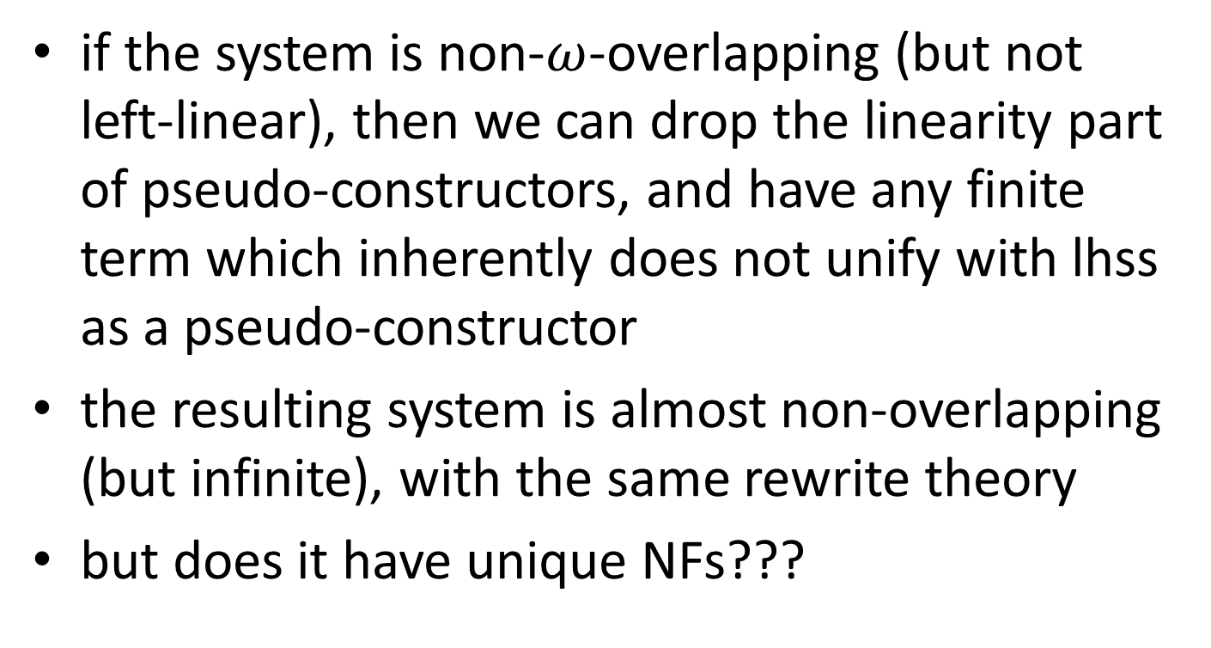
On a side note
if the system is non-$ω$-overlapping (but not left-linear), then we can drop the linearity part of pseudo-constructors, and have any finite term which inherently does not unify with lhss as a pseudo-constructor
the resulting system is almost non-overlapping (but infinite), with the same rewrite theory
but does it have unique NFs???

Slide 17
Future Work
these final question marks go back to our original motivation
if non-$ω$-overlapping constructor TRS have unique NFs then this is also the case for arbitrary non-$ω$-overlapping TRS; but “if”
one can use this to build normal form models:
data are (infinitary) constructor terms
infinitary, as substitutions on infinitary constructor terms have a CPO structure (more: Scott-Ershov domain)

